Slide 1
Advanced
C++ Programming
AMP Ganesh Prabhu, Bangalore,India
Notes:
Why this class??
C++ is a complex language, which takes years to master.
This class aims at presenting some features of C++, together with programming rules for developing high quality code in an industrial environment.

Slide 2
Introduction
C++ supports a variety of programming styles:
procedural (as FORTRAN, pascal, C, …)
object-oriented (as Eifel, JAVA, …)
generic
Features interact with each other.
C++ is very flexible & efficient
Notes:
Procedural programming :
A la c, Fortran, Pascal, etc.
The program design consists in defining functions and parameters, and how they are related to each other.
Because the relationships become more and more complex as the program grows, a solution to better separate independent parts of code and ease the evolution of programs has been to use an
Object-oriented Programming (OOP) :
With this type of method, the code is separated in small units which can be compiled separately. Each unit, or object, defines a set of functions related to that object. A function can be public (made available to other parts of the program) or private (internal to this object). Another feature of OOP is the use of inheritance, which allows to reuse common characteristics of several objects by abstracting them in “base objects”. Moreover, derived objects have the possibility (or the obligation) to redefine some of the functions of their parent object.

Slide 3
Introduction
The goal of this course is to provide insight into the advanced features and its internal working
To enable the participants to develop good object oriented design and use C++ effectively.

Slide 4
Prerequisites
A working knowledge of C++ and some basic object-oriented concepts.
What is a pointer ?
What is a class ?
What is inheritance ?

Slide 5
Outline
Module 1: Basic structure of C++ program
Module 2: Namespace
Module 3: Functions
Module 4: Object Model
Module 5: Initialization & Clean up
Module 6: Dynamic Memory Management
Module 7: Inheritance & Containment
Module 8: Templates and Generic programming
Module 9: Exception Handling

Slide 6
MODULE 1

Slide 7
Steps involved in the process of building the C++ program
COMPILERS, ASSEMBLERS and LINKERS
Normally the C/C++ program building process involves four stages and utilizes different ‘tools’ such as a preprocessor, compiler, assembler, and linker.
At the end there should be a single executable file.
The following slide illustrates the stages that happen in order regardless of the operating system/compiler.

Slide 8
Steps involved in the process of building the C++ program (contd..)
Source code file - .CPP
C++ Pre-processor
Preprocessed code
C++ compiler
Object code
Other object files/modules
C++ linker
Library files
Executable code- .EXE

Slide 9
Steps involved in the process of building the C++ program (contd..)
Preprocessing is the first pass of any C++ compilation.
  It processes include-files, conditional compilation instructions and macros.
Compilation is the second pass.
  It takes the output of the preprocessor, and the source code, and generates assembler source code.
Assembly is the third stage of compilation.
  It takes the assembly source code and produces an assembly listing with offsets. The assembler output is stored in an object file.

Slide 10
Steps involved in the process of building the C++ program (contd..)
Linking is the final stage of compilation.
  It takes one or more object files or libraries as input and combines them to produce a single (usually executable) file.
  In doing so, it resolves references to external symbols, assigns final addresses to procedures/functions and variables,
  and revises code and data to reflect new addresses (a process called relocation).

Slide 11
Memory Layout of a process
OBJECT FILES and EXECUTABLE
After the source code has been assembled, it will produce an Object files (e.g. .o, .obj) and then linked, producing an executable files.
An object and executable come in several formats such as
  ELF (Executable and Linking Format)
  COFF (Common Object-File Format) and
  PE (Portable Executable Format).
For example, ELF is used on Linux systems, while COFF is used on Unix systems & PE format is used on Windows systems.

Slide 12
Memory Layout of a process(contd..)
When we examine the content of these object files there are areas called sections.
Sections can hold executable code, data, dynamic linking information, debugging data, symbol tables, relocation information, comments, string tables, and notes.
Some sections are loaded into the process image and some provide information needed in the building of a process image while still others are used only in linking object files.

Slide 13
Memory Layout of a process(contd..)
System
env
argv
argc
mfp, frame pointer for main
Auto variables for main
STACK
Stack pointer (grows downward if func() calls another function)
Auto variables for func()
Available for stack growth
Library functions if dynamically linked
(.SO , .DLL)
Shared Memory
Available for heap growth
HEAP
(malloc/realloc arena)
Initialized and unintialized data
Global /static variables
DATA Segment
Compiled code
(our code + static libraries)
CODE/TEXT Segment

Slide 14
Memory Layout of a process(contd..)
There are several sections that are common to all executable formats (may be named differently, depending on the compiler/linker) as listed below:
.text
This section contains the executable instruction codes and is shared among every process running the same binary.
This section usually has READ and EXECUTE permissions only.
This section is the one most affected by optimization.
.bss
BSS stands for ‘Block Started by Symbol’.
It holds un-initialized global and static variables.
Since the BSS only holds variables that don't have any values yet, it doesn't actually need to store the image of these variables.

Slide 15
Memory Layout of a process(contd..)
The size that BSS will require at runtime is recorded in the object file, but the BSS (unlike the data section) doesn't take up any actual space in the object file.
.data
Contains the initialized global and static variables and their values.
It is usually the largest part of the executable. It usually has READ/WRITE permissions.
.rdata
Also known as .rodata (read-only data) section.
This contains constants and string literals.

Slide 16
Memory Layout of a process(contd..)
.reloc
Stores the information required for relocating the image while loading.
Symbol table
A symbol is basically a name and an address.
Symbol table holds information needed to locate and relocate a program’s symbolic definitions and references.
A symbol table index is a subscript into this array.
Index 0 designates both the first entry in the table and serves as the undefined symbol index.
The symbol table contains an array of symbol entries.

Slide 17
Memory Layout of a process(contd..)
Relocation records
Relocation is the process of connecting symbolic references with symbolic definitions. For example,
when a program calls a function, the associated call instruction must transfer control to the proper destination address at execution.
Re-locatable files must have relocation entries’ which are necessary because they contain information that describes how to modify their section contents, thus
allowing executable and shared object files to hold the right information for a process's program image.
Simply said relocation records are information used by the linker to adjust section contents.

Slide 18
Static and Dynamic link library
A library is a piece of pre-compiled (binary) code shipped to an end-user developer,
who can implement or consume the functionalities of the library without getting to see the actual code.
A library can be shipped generally in 2 different forms.
    Static link library &
    Dynamic link library

Slide 19
Static and Dynamic link library (contd..)
Static link library:
This is the simplest form amongst the two.
This library would get linked to the .OBJ file of the consumer during link time, and tend to be an integral part of the executable file.
These files go with the extension
  .LIB (Microsoft)
  .a (Linux, also called archive file)

Slide 20
Static and Dynamic link library (contd..)
Dynamic link library:
This library is independent of an executable file.
An executable file consuming a dynamic link library would be more compact or smaller in size when compared to an executable consuming a static link library.
The dynamic link library at any given point of time shall be single copy in main memory and could be shared by more than one executable file, thus making it more memory efficient when compared to static link libraries.
These files go with the extension
  .DLL (Microsoft)
  .SO (Linux, also called Shared object)

Slide 21
Why OO technology?

Slide 22
Dependency Management
What is dependency management?
What bearing does DM have on software?
What is the result of poor DM?
What is the advantage of good DM?

Slide 23
What is dependency management?
A simple idea - as interdependencies increase, features like reusability, flexibility, and maintainability decrease.
Dependency management is controlling interdependencies.

Slide 24
What bearing does DM have on software?
Coupling and cohesion are the eternal concerns of software development
One can say that OO is just a set of tools and techniques for Dependency Management

Slide 25
What is the penalty for practicing poor DM?
A system with poor dependency structure will typically exhibit these four negative traits:
It is rigid
It is fragile
It is not reusable
It has high viscosity

Slide 26
It is Rigid
Rigidity is the inability to be changed
The impact of a change cannot be predicted
If not predicted, it cannot be estimated
Time and cost cannot be quantified
Managers become reluctant to authorize change
Official Rigidity for “Roach Motel” modules

Slide 27


Changes with Rigidity
Officially Rigid Area
The System
Where the change should be made
Where the change must be made now
Are we containing risk, or spreading rot?

Slide 28

It is Fragile
Software changes seem to exhibit non-local effects
A single change requires a cascade of subsequent changes
New errors appear in areas that seem unconnected to the changed areas
Quality is unpredictable.
The development team loses credibility

Slide 29
Increasing Risk
Defects v. Cumulative Modifications
1.0
Probability of
introducing a bug
Changes
Systems tend to become increasingly fragile over time. Intentional, planned
partial rewrites may be necessary to sustain growth and maintenance.

Slide 30
It is not reusable
Desirable parts of the design are dependent upon undesirable parts
The work and risk of extracting the desirable part may exceed the cost of redeveloping
from scratch.

Slide 31
It has high viscosity
Viscosity is resistance to fluid motion.
When the “right changes” are much more difficult than hacking, the viscosity of the system is high.
Over time, it will become increasingly difficult to continue developing the product.

Slide 32




What is the benefit of good DM?
Interdependencies are managed, with firewalls separating aspects that need to vary independently.
Less fragile,
the bugs are boxed in
More Flexible
Easier to reuse
Fewer Trailers
Easier to make the right change
Slow the rot

Slide 33
MODULE 2

Slide 34
Namespaces
Namespace pollution
  Occurs when building large systems from pieces
  Identical globally-visible names clash
  How many programs have a “print” function?
  Very difficult to fix
Classes suggest a solution
class A { void f(); };
class B { void f(); };
Two f’s are separate

Slide 35
Namespaces (contd..)
Scope for enclosing otherwise global declarations
namespace Mine
{
void print(int);
const float pi = 3.1415925635;
class Shape { };
}
void bar(float y)
{
float x = y + Mine::pi;
Mine::print(5);
}

Slide 36
Namespaces (contd..)
using directive brings namespaces or objects into scope
namespace Mine
{
const float pi = 3.1415926535;
void print(int);
}
using Mine::print;
void foo() { print(5); } // invoke Mine::print
using namespace Mine;
float twopi = 2*pi; // Mine::pi

Slide 37
Namespaces (contd..)
Namespaces are open: declarations can be added
namespace Mine
{
void f(int);
}
namespace Mine
{
void g(int); // Add Mine::g()to Mine
}

Slide 38
Namespaces (contd..)
Declarations and definitions can be separated
namespace Mine
{
void f(int);
}
void Mine::f(int a)
{
/* … */
}

Slide 39
Function stack frames

Slide 40
MODULE 3

Slide 41
Function stack
One of the most important mechanisms a programmer should understand is the function call stack (sometimes referred to as the program execution stack).
This data structure working "behind the scenes“ supports the function call/return mechanism.
It also supports the creation, maintenance and destruction of each called function's automatic variables.
Each time a function calls another function, an entry is pushed onto the stack.

Slide 42
Function stack
This entry, called a stack frame or an activation record, contains the return address that the called function needs to return to the calling function.
Of course, the amount of memory in a computer is finite, so only a certain amount of memory can be used to store activation records on the function call stack.
If more function calls occur than can have their activation records stored on the function call stack, an error known as stack overflow occurs.

Slide 43
Function stack (Example)
// square function used to demonstrate the function
// call stack and activation records.
#include <iostream>
using std::cin;
using std::cout;
using std::endl;
int square( int ); // prototype for function square
int main()
{
int a = 10; // value to square (local automatic variable in main)
cout << a << " squared: " << square( a ) << endl; // display a squared
return 0; // indicate successful termination
} // end main
// returns the square of an integer
int square( int x ) // x is a local variable
{
return x * x; // calculate square and return result
} // end function square

Slide 44
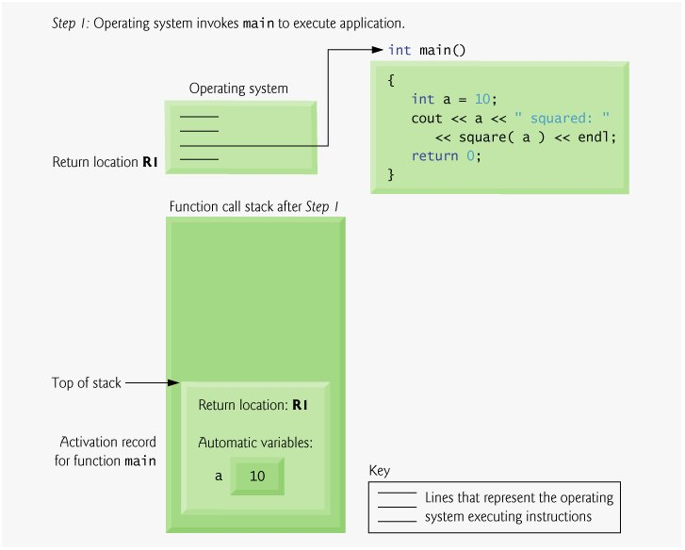
Function stack (Fig .1)

Slide 45
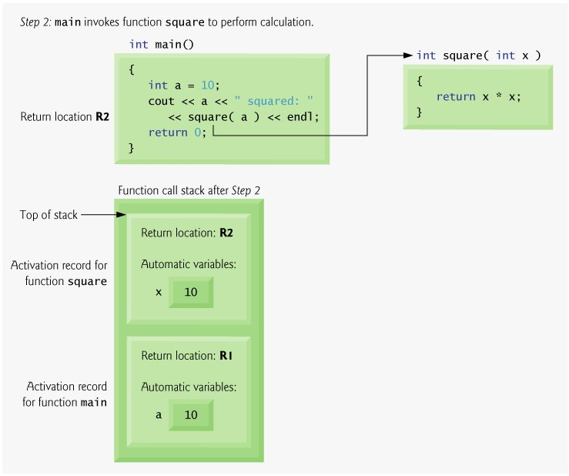
Function stack (Fig. 2)

Slide 46
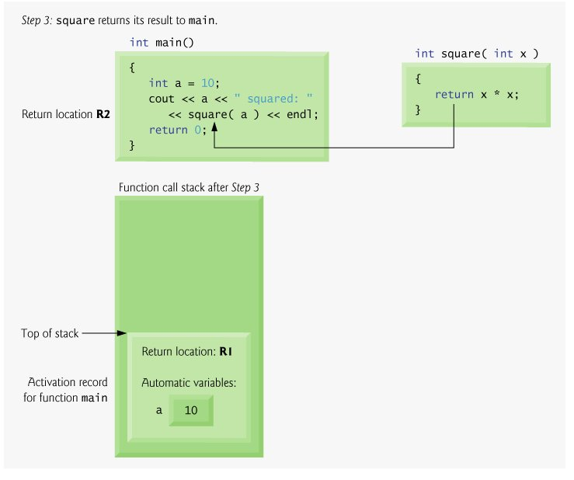
Function stack (Fig. 3)

Slide 47
CALLING CONVENTIONS
What Are Calling Conventions?
C++ provides a way of defining a function and a way of calling that function with arguments that soon become second nature to use.
  When the function and calls to it are compiled there are quite a few different ways in which the process of getting those arguments to where the function’s code can “see” them before executing the code can be performed.
  There are pros and cons to each, and some compilers have extensions which allow you to choose which is used.
  Most of the time there is no need to do anything other than use the defaults or, in a few cases where you are required to match a binary specification, do what you are told.
But you might want to make use of this in some cases, or simply understand what it is going on with calling conventions used by code you interface with.

Slide 48
CALLING CONVENTIONS (contd..)
Calling Conventions and “Pure C++”
The C++ Standard [ISO/IEC 14882] has very little to say about calling conventions. It has a bit to say about language linkage and linkage specifications, and it notes that a particular language linkage may be associated with a particular calling convention. Everything else related to calling conventions is implementation specific.
Types of Calling Conventions:
__cdecl
__stdcall
__fastcall
__thiscall

Slide 49
CALLING CONVENTIONS (contd..)
The Conventions
__cdecl
The __cdecl calling convention is used for functions marked with the __cdecl keyword, or for unmarked functions when the /Gd microsoft compiler option is set. Since /Gd is the default this is then the default calling convention.
All arguments are stored on the stack, in right to left order. The code that called the function will have to remove these arguments when the function returns.
Because the calling code cleans the stack this convention can be used with functions with a variable number of arguments such as printf(const char*, ...). Since C++ must allow such functions, as advisable as it is to avoid them when you can, it makes sense that this is the default calling convention.

Slide 50
CALLING CONVENTIONS (contd..)
__stdcall
The __stdcall calling convention is used for functions marked with the __stdcall keyword, or for unmarked functions when the /Gz compiler option(microsoft specific) is set.
All arguments are stored on the stack, in right to left order. The function itself will clean the stack. This results in slightly smaller executables but cannot be used with functions that take a variable number of arguments.
Microsoft specific:
COM methods, and the Windows API functions are generally __stdcall functions. The macros WINAPI and CALLBACK and a few others used in Windows API declarations expand to __stdcall.

Slide 51
CALLING CONVENTIONS (contd..)
__fastcall
The __fastcall calling convention is used for functions marked with the __fastcall keyword, or for unmarked functions when the /Gr compiler option (microsoft specific) is set (/Gr will not affect main()).
The first two arguments (left to right) which are 32bit or smaller are placed into two registers (currently ECX and EDX, though Microsoft have no commitment to keep using those two with later compilers). All other arguments are stored on the stack, in right to left order. The function itself will clean the stack.
If you attempt to take the address of an argument stored in a register it will be copied to a temporary location.
While reasons this would give an advantage in speed are clear, with modern machines it tends to be negligible.

Slide 52
CALLING CONVENTIONS (contd..)
__thiscall
The __thiscall calling convention cannot be explicitly used. It is used for member functions of classes which are not explicitly set to use a different convention, If the member functions takes a variable number of arguments, then a combination of __thiscall with __cdecl is used. If the member functions takes only fixed no. of parameters then the programmer has the choice __thiscall with __stdcall.
The convention operates much like __stdcall except that the this pointer (which is effectively a hidden argument) is stored in the ECX register. This neatly matches with the C++ rule that one cannot take the address of the this pointer.
In the case where a variable number of arguments requires __cdecl to be used the this pointer is considered the left-most argument, and hence pushed on the stack last.

Slide 53
CALLING CONVENTIONS (contd..)
Calling convention syntax in a C++ code:
Microsoft Compiler:
void fun(); -------→ void __cdecl fun();
GCC Compiler:
void fun(); -------→ void fun() __attribute((cdecl))__ ;

Slide 54
Linkage Specification
This is to tell the compiler that the following function is not defined in this program, and it is the compiler's job to look for the definition.
This is also to inform the compiler that the following function was compiled as C code.
C++ specially encodes method names for type-safe linkage, but C doesn’t.
So when an attempt is made to link C code with C++ code, the method compiled in C will not be directly recognized.
For a single method:
extern “C” method prototype
For multiple methods:
extern “C”
{ method prototypes }

Slide 55
Inline Functions
Function calls
  Cause execution-time overhead
  Qualifier inline before function return type "advises" a function to be inlined
    Puts copy of function's code in place of function call
  Speeds up performance but increases file size
  Compiler can ignore the inline qualifier
    Ignores all but the smallest functions
  inline double cube( const double s )
  { return s * s * s; }

Slide 56
FUNCTION POINTER
&
CALLBACKS

Slide 57
FUNCTION POINTER
Function Pointers provide some extremely interesting, efficient and elegant programming techniques.
You can use them to replace switch/if-statements, to realize your own late-binding or to implement callbacks.
Unfortunately -probably due to their complicated syntax - they are treated quite step motherly in most computer books and documentations. If at all, they are addressed quite briefly and superficially.
They are less error prone than normal pointers because you will never allocate or deallocate memory with them. All you've got to do is to understand what they are and to learn their syntax. But keep in mind: Always ask yourself if you really need a function pointer.

Slide 58
FUNCTION POINTER (contd..)
It's nice to realize one's own late-binding but to use the existing structures of C++ may make your code more readable and clear.
One aspect in the case of late-binding is runtime: If you call a virtual function, your program has got to determine which one has got to be called. It does this using a V-Table containing address of all the possible functions.
This costs some time for each call and maybe you can save some time using function pointers instead of virtual functions.

Slide 59
FUNCTION POINTER (contd..)
What is a Function Pointer?
Function Pointers are pointers, i.e. variables, which point to the address of a function.
You must keep in mind, that a running program gets a certain space in the main-memory.
Both, the executable compiled program code and the used variables, are put inside this memory. Thus a function in the program code is, like e.g. a character field, nothing else than an address.

Slide 60
FUNCTION POINTER (contd..)
Define a Function Pointer:
Regarding their syntax, there are two different types of function pointers:
  Pointers to ordinary C functions or to static C++ member functions.
  Pointers to non-static C++ member functions.
The basic difference is that all pointers to non-static member functions need a hidden argument: The this-pointer to an instance of the class.
Always keep in mind: These two types of function pointers are incompatible with each other.

Slide 61
FUNCTION POINTER (contd..)
Since a function pointer is nothing else than a variable, it must be defined as usual. In the following example we define three function pointers named pt2Function, pt2Member and pt2ConstMember.
They point to functions, which take one float and two char and return an int.
In the C++ example it is assumed, that the functions, our pointers point to, are (non-static) member functions of TMyClass.
// define a function pointer and initialize to NULL
int (*pt2Function)(float, char, char) = NULL; // C int (TMyClass::*pt2Member)(float, char, char) = NULL; // C++ int (TMyClass::*pt2ConstMember)(float, char, char) const = NULL; // C++
Important note: A function pointer always points to a function with a specific signature! Thus all functions, you want to use with the same function pointer, must have the same parameters and return-type!

Slide 62
FUNCTION POINTER (contd..)
Calling Convention & Function pointers:
Normally you don't have to think about a function's calling convention: The compiler assumes __cdecl as default if you don't specify another convention.
However if we want to specify our own ... The calling convention belongs to a function's signature: Thus functions and function pointers with different calling convention are incompatible with each other!
For Borland and Microsoft compilers you specify a specific calling convention between the return type and the function's or function pointer's name.

Slide 63
FUNCTION POINTER (contd..)
Calling Convention & Function pointers: (Contd..)
For the GNU GCC you use the __attribute__ keyword: Write the function definition followed by the keyword __attribute__ and then state the calling convention in double parentheses.
// define the calling convention
void __cdecl DoIt(float a, char b, char c); //Borland & Microsoft compiler
void DoIt(float a, char b, char c) __attribute__((cdecl)); // GNU GCC

Slide 64
FUNCTION POINTER (contd..)
Assign an address to a Function Pointer:
It's quite easy to assign the address of a function to a function pointer. You simply take the name of a suitable and known function or member function.
Although it's optional for most compilers you should use the address operator ‘&’ in front of the function's name in order to write portable code.
You may have got to use the complete name of the member function including class-name and scope-resolution operator (::).

Slide 65
FUNCTION POINTER (contd..)
Also you have got to ensure, that you are allowed to access the function right in scope where your assignment stands.
// assign an address to the function pointer
// Note: Although you may omit the address operator on most compilers
// you should always use the correct way in order to write portable code. //In ‘C’
int DoIt (float a, char b, char c) { printf("DoIt\n"); return a+b+c; }
int DoMore(float a, char b, char c)const
{
printf("DoMore\n");
return a-b+c;
}
pt2Function = DoIt; // short form
pt2Function = &DoMore; // correct assignment using address operator

Slide 66
FUNCTION POINTER (contd..)
// C++
class TMyClass
{
public:
int DoIt(float a, char b, char c)
{ cout << "TMyClass::DoIt"<< endl; return a+b+c;};
int DoMore(float a, char b, char c) const
{ cout << "TMyClass::DoMore" << endl; return a-b+c; };
/* more of TMyClass */
};
pt2ConstMember = &TMyClass::DoMore; // correct assignment using ‘&’ operator
pt2Member = &TMyClass::DoIt; // note: <pt2Member> may also legally point to &DoMore

Slide 67
FUNCTION POINTER (contd..)
Calling a Function using a Function Pointer
In C you call a function using a function pointer by explicitly de-referencing it using the * operator.
Alternatively you may also just use the function pointer's instead of the function’s name.
In C++ the two operators .* and ->* are used together with an instance of a class in order to call one of their (non-static) member functions.
If the call takes place within another member function you may use the this-pointer.

Slide 68
FUNCTION POINTER (contd..)
// calling a function using a function pointer
int result1 = pt2Function (12, 'a', 'b'); // C short way
int result2 = (*pt2Function) (12, 'a', 'b'); //
TMyClass instance1;
int result3 = (instance1.*pt2Member)(12, 'a', 'b'); // C++
int result4 = (*this.*pt2Member)(12, 'a', 'b');
// C++ if this-pointer can be used
TMyClass* instance2 = new TMyClass;
int result4 = (instance2->*pt2Member)(12, 'a', 'b'); // C++, instance2 is a pointer
delete instance2;

Slide 69
Function Overloading
Function overloading:
  Functions with same name and different parameters
  Overloaded functions should perform similar tasks
    Function to square ints and function to square floats
  int square( int x) {return x * x;}
  float square(float x) { return x * x; }
  Program chooses function by signature
    Signature determined by function name and parameter types
    Type safe linkage - ensures proper overloaded function called

Slide 70
Function Overloading (Contd..)
1 //An example
2 // Using overloaded functions
3 #include <iostream>
4
5 using std::cout;
6 using std::endl;
7
8 int square( int x ) { return x * x; }
9
10 double square( double y ) { return y * y; }
11
12 int main()
13 {
14 cout << "The square of integer 7 is " << square( 7 )
15 << "\nThe square of double 7.5 is " << square( 7.5 )
16 << endl;
17
18 return 0;
OUTPUT
The square of integer 7 is 49
The square of double 7.5 is 56.25
19 }

Slide 71
Call by value & reference
When passing a value, in either case, the call will look the same, it’s the receiving method which determines how the pass is made.
By Value:
void aMethod(aParameter p) { }
When passing by value a temporary COPY is made in memory taking up space and making any changes to the variable useless outside of the aMethod scope. Once control returns to the calling procedure any changes to the variable will not be recognized, and you will still have the original variable.

Slide 72
Call by value & reference
By Reference:
void aMethod(aParameter& p) { }
NOTE: the & can be place either against the parameter type, against the parameter name, or there can be a space on either side.
Eg:
By value: void fun(int x, int y){ ….}
By Reference: void fun(int &x, int &y){…}

Slide 73
Function Templates
Function templates
  Compact way to make overloaded functions
  Keyword template
  Keyword class or typename before every formal type parameter (built in or user defined)
  template < typename T > T square( T value1)
  {
  return value1 * value1;
  }
  T replaced by type parameter in function call
      int x;
      int y = square(x);
      If int parameter, all T's become ints
      Can use float, double, long...

Slide 74
Function Templates (Example)
1 // An example on
2 // Using a function template
3 #include <iostream>
4
5 using std::cout;
6 using std::cin;
7 using std::endl;
8
9 template < class T >
10 T maximum( T value1, T value2, T value3 )
11 {
12 T max = value1;
13
14 if ( value2 > max )
15 max = value2;
16
17 if ( value3 > max )
18 max = value3;
19
20 return max;
21 }
22
23 int main()
24 {
25 int int1, int2, int3;
26
27 cout << "Input three integer values: ";
28 cin >> int1 >> int2 >> int3;
29 cout << "The maximum integer value is: "
30 << maximum( int1, int2, int3 ); // int version

Slide 75
Function Templates (Example – contd..)
31
32 double double1, double2, double3;
33
34 cout << "\nInput three double values: ";
35 cin >> double1 >> double2 >> double3;
36 cout << "The maximum double value is: "
37 << maximum( double1, double2, double3 ); // double version
38
39 char char1, char2, char3;
40
41 cout << "\nInput three characters: ";
42 cin >> char1 >> char2 >> char3;
43 cout << "The maximum character value is: "
44 << maximum( char1, char2, char3 ) // char version
45 << endl;
46
47 return 0;
Input three integer values: 1 2 3
The maximum integer value is: 3
Input three double values: 3.3 2.2 1.1
The maximum double value is: 3.3
Input three characters: A C B
The maximum character value is: C
48 }

Slide 76
Overloading Vs. Generic
Function overloading when ?
We go for overloading when the functions business logic should change with input types.
Function Template when ?
We go for templates when irrespective of the input types the business logic of the function remains same.

Slide 77
Function template Internals
With a function template we realize the compiler carries out a process called instantiation.
Instantiation is a process where the compiler generates type specific code out of the template plan.
This happens during compile-time by the compiler, subject to the compiler can figure out the needs of the template consumer.
Effectively this is another form of overloading, a responsibility taken by the compiler and not the programmer.

Slide 78
Function Template Specialization
Consider the following Generic function:
template<typename T1, typename T2>
void Add(T1 a, T2 b)
{….}
Complete specialization of the above for ‘char’ type
template<> //template<> usage is optional.
void Add(char a, char b)
{….}
A partial specialization of the above generic code is not possible.

Slide 79
MODULE 4

Slide 80
OBJECT MODEL

Slide 81
Simple object model
Our first object model is very simple. It might be used for a C++ implementation
Designed to minimize the complexity of the compiler at the expense of space and run-time efficiency.
In this model, an object is a sequence of slots, where each slot points to a member.
The members are assigned a slot in the order of their declarations.
The no. of slots would equal the total number of members

Slide 82
Simple object model (contd..)
class CA
{
private:
int a,b;
public:
void fun1(){ }
void fun2(){ }
};
int CA::a
int CA::b
void CA::fun1(){ }
void CA::fun2(){ }
CA obj;

Slide 83
Table-driven object model
For an implementation to maintain a uniform representation for the objects of all classes, an alternative object model might factor out all member specific information, placing it in a data member and member function pair of tables.
class CA
{
private:
int a,b;
public:
void fun1(){ }
void fun2(){ }
};
int CA::a
int CA::b
Member Data table
CA obj;
& void CA::fun1(){ }
Member function table (holds addresses)
& void CA::fun2(){ }

Slide 84
C++ object model
Stroustrup’s original (and still prevailing) C++ object model is derived from the simple object model by optimizing for space and access time.
Non-static data members are allocated directly within each class object. Static data members are stored outside the individual class object.
class CA
{
private:
int a,b;
public:
void fun1(){ }
void fun2(){ }
};
int CA::a
This pointer
int CA::b
CA obj;
void CA::fun1(){ }
void CA::fun2(){ }

Slide 85
Class internals
Every member function of a class has an hidden formal parameter called the ‘this’ pointer.
The hidden formal parameter is designed to hold the address of the object which was responsible for calling that member function.
The compiler translates the code into a more detailed form as illustrated in the subsequent slide. Consider the following piece of code.
class CA
{
private:
int a,b;
public:
CA();
CA(int);
CA(int,int);
~CA();
void print() const; //A const method
};

Slide 86
Class internals
CA::CA(){ .. } ---> CA::CA(CA * const this) { ...}
CA::CA(int x){ .. } ---> CA::CA(CA *const this, int x){ ... }
CA::CA(int x, int y){..} ---> CA::CA(CA *const this, int x, int y) { ...}
CA::~CA(){ .. } ----> CA::~CA(CA *const this){ .. }
void CA::print() const {…..} ----> void CA::print(const CA * const this){..}
main()
{
CA obj1; // obj1.CA::CA(); ---> CA::CA(&obj1);
CA obj2(200); // obj2.CA::CA(200); --> CA::CA(&obj2, 200);
CA obj3(30,40); // obj3.CA::CA(30,40); --> CA::CA(&obj3, 30,40);
//.....
obj1.print(); // CA::print(&obj1);
obj3.CA::~CA(); ---> CA::~CA(&obj3);
obj2.CA::~CA(); ---> CA::~CA(&obj2);
obj1.CA::~CA(); ---> CA::~CA(&obj1);
}

Slide 87
Single level Inheritance
Base
class
class CA
{
//……………….
};
class CB: public CA
{
//……………
};
CA
Derived
class
CB

Slide 88
Multi-level Inheritance
class CA
{
//……………….
};
class CB: public CA
{
//……………
};
class CC: public CB
{
//……………
};
class CD: public CC
{
//……………
};
CA
CB
CC
CD

Slide 89
One-to-many Inheritance
class CA
{
//……………….
};
class CB: public CA
{
//……………
};
class CC: public CA
{
//……………
};
class CD: public CA
{
//……………
};
CA
CB
CC
CD

Slide 90
Multiple Inheritance
class CA
{
//……………….
};
class CB
{
//……………
};
class CC
{
//……………
};
class CD: public CA,public CB, public CC
{
//……………
};
CA
CB
CC
CD

Slide 91
Hybrid Inheritance (dreaded diamond)
class CA
{
//……………….
};
class CB:public CA
{
//……………
};
class CC:public CA
{
//……………
};
class CD: public CB, public CC
{
//……………
};
CA
CB
CC
CD

Slide 92
Object Layout
class CA //BASE CLASS
{
private:
int a,b;
public:
//...
};
class CB:public CA //DERIVED CLASS
{
private:
int a,b;
public:
//....
};
CA::a
CA::b
CA OBJECT LAYOUT
CA::a
Sub object
CA::b
CB::a
CB::b
CB OBJECT LAYOUT

Slide 93
Static Members

Slide 94
static Class Members
static class members
  Shared by all objects of a class
    Normally, each object gets its own copy of each variable
  Efficient when a single copy of data is enough
    Only the static variable has to be updated
  May seem like global variables, but have class scope
    Only accessible to objects of same class
  Initialized at file scope
  Exist even if no instances (objects) of the class exist
  Can be variables or functions
    public, private, or protected

Slide 95
static Class Members (II)
Accessing static members
  public static variables: accessible through any object of the class
    Or use class name and (::)
    Employee::count
  private static variables: a public static member function must be used.
    Prefix with class name and (::)
    Employee::getCount()
  static member functions cannot access non-static data or functions
    No this pointer, function exists independent of objects

Slide 96
Static Member Example
#include<iostream>
using namespace std;
class Employee
{
private:
static int E_count;
public:
Employee()
{
E_count = E_count + 1;
}
virtual ~Employee() //Destructor must be virtual
{ E_count = E_count - 1; }
static void Emp_Count();
};
int Employee::E_count=0;
void Employee::Emp_Count()
{
cout <<"Total no. of Employee objects " << E_count << endl;
}
//------------------------------------------

Slide 97
Static Member Example (contd..)
class Perm_Emp:public Employee
{
private:
static int P_count;
public:
Perm_Emp() { P_count = P_count + 1; }
~Perm_Emp(){ P_count = P_count - 1; }
static void Perm_Count();
};
int Perm_Emp::P_count=0;
void Perm_Emp::Perm_Count()
{ cout <<"Total no. of Permanent Employee objects " << P_count << endl; }
//--------------------------------------------
class Temp_Emp:public Employee
{
private:
static int T_count;
public:
Temp_Emp() { T_count = T_count + 1; }
~Temp_Emp(){ T_count = T_count - 1; }
static void Temp_Count();
};

Slide 98
Static Member Example (contd..)
int Temp_Emp::T_count=0;
void Temp_Emp::Temp_Count()
{
cout <<"Total no. of Temporary Employee objects " << T_count << endl;
}
void main()
{
Employee *p1 = new(nothrow) Perm_Emp;
Employee *p2 = new(nothrow) Perm_Emp;
Employee *p3 = new(nothrow) Temp_Emp;
Employee::Emp_Count();
Perm_Emp::Perm_Count();
Temp_Emp::Temp_Count();
cout <<"-----------------"<<endl;
delete p1;
delete p3;
Employee::Emp_Count();
Perm_Emp::Perm_Count();
Temp_Emp::Temp_Count();
cout <<"-----------------"<<endl;
delete p2;
Employee::Emp_Count();
}

Slide 99
Static Member Example (output)
Total no. of Employee objects 3
Total no. of Permanent Employee objects 2
Total no. of Temporary Employee objects 1
-----------------
Total no. of Employee objects 1
Total no. of Permanent Employee objects 1
Total no. of Temporary Employee objects 0
-----------------
Total no. of Employee objects 0

Slide 100
mutable Class Member
C++ provides mutable class member as an alternative to const_cast.
A mutable data member is always modifiable even in a const method of a const object.
The difference between const_cast and mutable is:
  for a non-mutable data member in a const method, every time you modify it, you have to use const_cast.
  This actually reduces the chance of accidental modification.

Slide 101
mutable Class Member USAGE
class Screen
{
private:
int N_rows, N_cols;
mutable int R_location, C_Location;
public:
//….
};
const Screen TextMode(25,80,1,1);
Given the above example the R_Location and C_Location are the only data members modifiable on the Screen object which is ‘const’.
Note: ‘mutable’ is class level qualifier, not applicable for global or local variables.

Slide 102
Operator Overloading

Slide 103
Introduction (II)
Operator overloading
  Use traditional operators with user-defined objects
  Straightforward and natural way to extend C++
  Requires great care
    When overloading misused, program difficult to understand

Slide 104
Fundamentals of Operator Overloading
Use operator overloading to improve readability
  Avoid excessive or inconsistent usage
Format
  Write function definition as normal
  Function name is keyword operator followed by the symbol for the operator being overloaded.
  operator+ would be used to overload the addition operator (+)

Slide 105
Fundamentals of Operator Overloading (II)
Assignment operator (=)
  may be used with every class without explicit overloading
  memberwise assignment
  Same is true for the address operator (&)

Slide 106
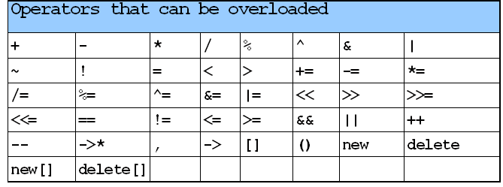
Restrictions on Operator Overloading
Most of C++’s operators can be overloaded

Slide 107
Restrictions on Operator Overloading (II)
Arity (number of operands) cannot be changed
  Urnary operators remain urnary, and binary operators remain binary
  Operators &, *, + and - each have unary and binary versions
    Unary and binary versions can be overloaded separately

Slide 108
Restrictions on Operator Overloading (III)
No new operators can be created
  Use only existing operators
Built-in types
  Cannot overload operators
  You cannot change how two integers are added

Slide 109
Operator Functions as Class Members vs. as friend Functions
Operator functions
  Can be member or non-member functions
Overloading the assignment operators
  i.e:(), [], ->,=
  Operator must be a member function

Slide 110
Operator Functions as Class Members vs. as friend Functions (II)
Operator functions as member functions
  Leftmost operand must be an object (or reference to an object) of the class
  If left operand of a different type, operator function must be a non-member function
  A non-member operator function must be a friend if private or protected members of that class are accessed directly

Slide 111
Operator Functions as Class Members vs. as friend Functions (III)
Non-member overloaded operator functions
  Enable the operator to be commutative
  HugeInteger bigInteger;
  int integer;
  bigInteger = integer + bigInteger;
  or
  bigInteger = biginteger + integer;

Slide 112
Overloading Stream-Insertion and Stream-Extraction Operators
Overloaded << and >> operators
  Must have left operand of types ostream &, istream & respectively
  It must be a non-member function (left operand not an object of the class)
  It must be a friend function if it accesses private data members

Slide 113
Example
1 //An example on
2 // Overloading the stream-insertion and
3 // stream-extraction operators.
4 #include <iostream>
5
6 using std::cout;
7 using std::cin;
8 using std::endl;
9 using std::ostream;
10 using std::istream;
11
12 #include <iomanip>
13
14 using std::setw;
15
16 class PhoneNumber {
17 friend ostream &operator<<( ostream&, const PhoneNumber & );
18 friend istream &operator>>( istream&, PhoneNumber & );
19
20 private:
21 char areaCode[ 4 ]; // 3-digit area code and null
22 char exchange[ 4 ]; // 3-digit exchange and null
23 char line[ 5 ]; // 4-digit line and null
24 };
25
26 // Overloaded stream-insertion operator (cannot be
27 // a member function if we would like to invoke it with
28 // cout << somePhoneNumber;).
29 ostream &operator<<( ostream &output, const PhoneNumber &num )
30 {

Slide 114
Example (contd..)
31 output << "(" << num.areaCode << ") "
32 << num.exchange << "-" << num.line;
33 return output; // enables cout << a << b << c;
34 }
35
36 istream &operator>>( istream &input, PhoneNumber &num )
37 {
38 input.ignore(); // skip (
39 input >> setw( 4 ) >> num.areaCode; // input area code
40 input.ignore( 2 ); // skip ) and space
41 input >> setw( 4 ) >> num.exchange; // input exchange
42 input.ignore(); // skip dash (-)
43 input >> setw( 5 ) >> num.line; // input line
44 return input; // enables cin >> a >> b >> c;
45 }
46
47 int main()
48 {
49 PhoneNumber phone; // create object phone
50
51 cout << "Enter phone number in the form (123) 456-7890:\n";
52
53 // cin >> phone invokes operator>> function by
54 // issuing the call operator>>( cin, phone ).
55 cin >> phone;
56
57 // cout << phone invokes operator<< function by
58 // issuing the call operator<<( cout, phone ).
59 cout << "The phone number entered was: " << phone << endl;
60 return 0;
61 }

Slide 115
Program Output
OUTPUT:
Enter phone number in the form (123) 456-7890:
(800) 555-1212
The phone number entered was: (800) 555-1212

Slide 116
Overloading Unary Operators
Overloading unary operators
  Avoid friend functions and friend classes unless absolutely necessary.
  Use of friends forcefully violates the encapsulation of a class.
  As a member function:
  class String
  {
  public:
  bool operator!() const;
  ...
  };

Slide 117
Overloading Binary Operators
Overloaded binary operators
  Non-static member function, one argument
  Non-member function, two arguments
class String
{
public:
const String &operator+=( const String & );
...
};
  y += z;
  equivalent to
  y.operator+=( z );

Slide 118
Overloading Binary Operators
Example
class String
{
friend const String &operator+=
( String &, const String & );
...
};
  y += z;
  equivalent to
  operator+=( y, z );

Slide 119
Converting between Types
Cast operator
  Convert objects into built-in types or other objects
  Conversion operator must be a non-static member function.
  Cannot be a friend function
  Do not specify return type
  For user-defined class A
  A::operator char *() const; // A to char
  A::operator int() const; //A to int
  A::operator otherClass() const; //A to otherClass
  When compiler sees (char *) s it calls
s.operator char*()

Slide 120
Converting between Types (II)
The compiler can call these functions to create temporary objects.
  If s is not of type char *
  Calls A::operator char *() const; for
cout << s;

Slide 121
Overloading Unary Operators
Pre/post-incrementing/decrementing operators
  Can be overloaded
  How does the compiler distinguish between the two?
  Prefix versions overloaded same as any other prefix unary operator would be. i.e. d1.operator++(); for ++d1;
Postfix versions
  When compiler sees postincrementing expression, such as
  d1++;
  Generates the member-function call
  d1.operator++( 0 );
  Prototype:
  Date::operator++( int );

Slide 122
MODULE 5

Slide 123
Constructor
A constructor is a special method or member function of a class, incidentally taking the name of the class as the method name.
It is a method that does not return any value or has any return type associated with it.
This method may or may not take any formal parameters. That is it can be overloaded if desired.
This method is called ‘constructor’ for the reason, It would get implicitly invoked by an object at the time of its construction hence the name CONSTRUCTOR.

Slide 124
Constructor (contd..)
This method by itself does not do anything on the object,
It is the programmer’s responsibility to state inside the function body as to what he/she wishes to accomplish on the object at the time of its construction.
A constructor method that does not take any known formal parameter is also called ‘default constructor’.

Slide 125
Destructor
A destructor is a special method or member function of a class taking the name of the class as its method name only prefixed with a ‘~’ tilde symbol.
This method does not return any value or has any return type associated with it.
This method does take any known formal parameters either. That is it cannot be overloaded.
This method is called ‘destructor’ for the reason, it would get implicitly invoked by an object at the time of object’s destruction hence the name DESTRUCTOR.

Slide 126
Destructor (contd..)
If there is any clean-up job a programmer wishes to accomplish at the time of the object’s destruction, then such business can be employed inside this method.
Note:
It is not compulsory to have constructor or destructor methods in a class. These methods are need based.
At the same time it does not mean that if a class has constructor method(s) we should also have destructor method.
The compiler does not assume a default constructor or destructor method unless and until we provide one.
There are certain specific scenarios where a compiler would assume default constructor and destructor methods. These scenarios are highlighted in the slides to follow.

Slide 127
Default constructor synthesis
Case 1:
Base class has a default constructor but derived class does not have one. Then the compile would assume a default constructor for the derived class.
class CA
{
public:
CA(){ }
};
class CB:public CA
{
public:
//no default constructor provided, compiler will assume one
};

Slide 128
Default constructor synthesis
Case 2:
A class exhibits containment i.e one or more data members of the class is an object of another class. This container class does not have a default constructor, whereas the contained objects class has a default constructor, then the compiler would assume a default constructor for the container class.
class CA
{
public:
CA(){ }
};
class CB
{
CA obj1; //CB has-a CA
public:
//no default constructor provided, compiler will assume one
};

Slide 129
Default constructor synthesis
Case 3:
When a class CD multiple inherits virtually. Default constructors for class CB,CC & CD would be automatically assumed by the compiler.
class CA {…. };
class CB: virtual public CA {…. };
class CC: virtual public CA {…};
class CD :public CB, public CC {…};

Slide 130
Default constructor synthesis
Case 4:
All polymorphic classes that do not have a default constructor provided by the programmer, then the compiler would assume a default constructor for such classes.
class CA
{
public:
//no default constructor provided, but compiler will assume one.
virtual void fun(){ }
};
The above cases are aptly applicable for destructor methods as well.

Slide 131
Initializer list
One of the primary jobs a programmer would wish to use the constructor for is to initialize the object at the time of its construction.
Consider the following class.
class rectangle
{
private:
int base, height;
public:
//constructor placing values in objects data
rectangle(int x=0, int y=0)
{
base=x;
height=y;
}
};
The constructor in the above example is rather doing an assignment.

Slide 132
Initializer list (contd..)
Prefer initialization to assignment, which is more efficient. How? The example revised
class rectangle
{
private:
int base, height;
public:
rectangle(int x=0, int y=0):base(x), height(y) //initialization
//list
{
// base=x; //avoid these statements
// height=y;
}
};
NOTE: It is suggested that the order of the data members listed in the initializer-list shall be in the order of declaration.

Slide 133
Shallow copy and Assignment
All compiler synthesized copy constructors exhibit shallow copy, also called bit-wise copy or member-to-member copy.
Such approaches may not be a good idea in problem situations where the class exhibits containment or aggregation.
Similarly the same is true for assignment functions synthesized by the compiler, also called shallow assignment, bit-wise assignment or member-to-member assignment.

Slide 134
Containment (HAS-A relationship)
STACK
CB obj1
CB obj2
CA *p
CA *p
&&
&&
CB obj1(10,20);
CB obj2(30,40);
HEAP
CA::a
10
CA::a
30
CA::b
20
CA::b
40
CA
CA

Slide 135
Shallow Copy
STACK
CB obj1
CB obj2
CA *p
CA *p
Shallow
copy
&&
&&
CB obj2(obj1);
compiler synthesized
copy constructor
CB(const CB &x):p(x.p) {..}
HEAP
CA::a
10
CA::b
20
CA

Slide 136
Shallow Assignment
STACK
CB obj3
CB obj4
CA *p
CA *p
CB obj3(40,50), obj4;
Obj4 = obj3;
compiler synthesized
Assignment function
void operator =(const CB &x)
{
p = x.p;
}
Shallow
assignment
&&
&&
HEAP
CA::a
40
CA::a
0
CA::b
50
CA::b
0
CA
CA
LEAKED MEMORY

Slide 137
Deep copy and Assignment
When under situations the compiler synthesized copy constructor is not a good idea we need to go in for custom copy constructor to tackle the issues.
Note: If any reason the programmer feels the need to have a custom copy constructor then also make it a point to introduce the assignment function as well.

Slide 138
Deep Copy
STACK
CB obj2(obj1);
Custom copy constructor
CB(const CB &x)
{
p = new(nothrow) CA(*(x.p));
}
CB obj1
CB obj2
CA *p
CA *p
&&
&&
HEAP
CA::a
10
deep
copy
CA::a
10
CA::b
20
CA::b
20
CA
CA

Slide 139
Deep Assignment
STACK
CB obj3
CB obj4
CA *p
CA *p
CB obj3(40,50), obj4;
Obj4 = obj3;
Custom Assignment function
void operator =(const CB &x)
{
*(this->p) = *(x.p);
}
&&
&&
HEAP
CA::a
40
deep
assignment
CA::a
40
CA::b
50
CA::b
50
CA
CA

Slide 140
Preventing object destruction
#include<iostream>
using namespace std;
//preventing object destruction in the destructor
class CA
{
private:
int a,b;
public:
CA(int x=0, int y=0):a(x),b(y)
{
cout <<"CA - constructor" << endl;
}
~CA()
{
if(b==0)
throw b;
cout <<"CA destructed " << endl;
}
void print()
{
cout <<a<<","<<b<<endl;
}
};

Slide 141
Preventing object destruction
void main()
{
CA *p;
try
{
p = new CA(10,10);
p->print();
p->CA::CA();
delete p;
}
catch(int x) {cout <<"caught int - exception" << x <<endl; }
p->print(); //object continues to exist..
}

Slide 142
EXPLICIT CONSTRUCTOR
When a method is expecting an object which has a one-argument constructor but you pass the argument, compiler will implicitly call that one-argument constructor and convert that passed argument to the object:
class Base
{
public:
Base(int a) : member(a)
{
cout << "Base constructor called with " << a << endl;
}
int member;
};
void test(Base obj1)
{ cout << "Base object's member = " << obj1.member; }

Slide 143
EXPLICIT CONSTRUCTOR(contd..)
int main()
{
test(333);
}
The output will be:
Base constructor called with 333
Base object's member = 333
In same cases such an automatic implicit conversion may cause trouble.
You can use keyword explicit in front of the constructor to suppress the implicit conversion.
If you want to convert, you have to use explicit conversion such as static_cast, without which compiler will reject the conversion and prompt error message.

Slide 144
EXPLICIT CONSTRUCTOR -Usage
class Base
{
public:
explicit Base(int a) : member(a)
{
cout << "Base constructor called with " << a << endl;
}
int member;
};
void test(Base obj1)
{
cout << "Base object's member = " << obj1.member;
}
int main()
{
test( static_cast<Base>(333) );
return 0;
}

Slide 145
Patterns & Techniques for construction
#include<iostream>
using namespace std;
//Prevent object instance
class CA
{
private:
CA();
~CA();
public:
//…
};
void main()
{
CA *p = new(nothrow) CA; //ERROR
CA obj; //ERROR
}

Slide 146
Patterns & Techniques for construction (contd..)
#include<iostream>
using namespace std;
//Prevent Stack based object
class CA
{
private:
CA() { }
public:
static CA* create_heapinst()
{
return new CA;
}
};
void main()
{
CA *p = CA::create_heapinst();
//CA obj; ERROR
}

Slide 147
Patterns & Techniques for construction (contd..)
#include<iostream>
#include<new>
using namespace std;
// preventing heap based object
class CA
{
private:
void *operator new(size_t size) { return 0; }
void operator delete(void *pv) { }
void * operator new[](size_t size) { return 0; }
void operator delete[](void *pv) { }
public:
//.....
};
void main()
{
CA obj1;
}

Slide 148
Patterns & Techniques for construction (contd..)
#include<iostream>
#include<new>
using namespace std;
//Identifying object is on heap or stack
bool isonheap;
class CA
{
public:
CA()
{
if(isonheap)
cout <<"object created in heap"<<endl;
else
cout <<"object created on stack " << endl;
isonheap = false;
}
void * operator new(size_t size)
{
isonheap = true;
return ::operator new(size); //call the global new operator
}

Slide 149
Patterns & Techniques for construction (contd..)
//Identifying object is on heap or stack (contd..)
void * operator new[](size_t size)
{
cout <<"void * operator new[](size_t size) - called"<<endl;
isonheap = true;
return malloc(size);
}
};
void main()
{
CA *p = new CA;
CA obj;
cout <<" p = "<< p << endl;
cout <<"& obj = " << &obj <<endl;
}

Slide 150
MODULE 6

Slide 151
new & delete

Slide 152
Dynamic Memory Allocation with Operators new and delete
new and delete
  new - automatically creates object of proper size, calls constructor, returns pointer of the correct type
  delete - destroys object and frees space
  Better dynamic memory allocation than C’s malloc and free
Example:
  TypeName *typeNamePtr;
    Creates pointer to a TypeName object
  typeNamePtr = new TypeName;
    new creates TypeName object, returns pointer (which typeNamePtr is set equal to)
  delete typeNamePtr;
    Calls destructor for TypeName object and frees memory

Slide 153
Dynamic Memory Allocation with Operators new and delete (II)
Initializing objects
  double *thingPtr = new double( 3.14159 );
  Initializes object of type double to 3.14159
  int *arrayPtr = new int[ 10 ];
  Create ten element int array, assign to arrayPtr.
  Use
    delete [] arrayPtr;
    to delete arrays

Slide 154
Pointers and Dynamic Memory Management
Static memory is used to store the values of global variables, as well as static variables within functions and classes.
Stack-based memory is implicitly managed by function calls and function returns.
Heap-based memory is used to dynamically manage memory as a result of a program’s request, such as Java's new call.
All temporaries created in a statement (numeric values, objects) are allocated from the stack and destroyed at the end of statement.
string language = string ("C") + "++";
Static memory is by default set zero at the start of the program; no other memory is initialized by default (all un-initialized primitive variables contain unspecified random values).

Slide 155
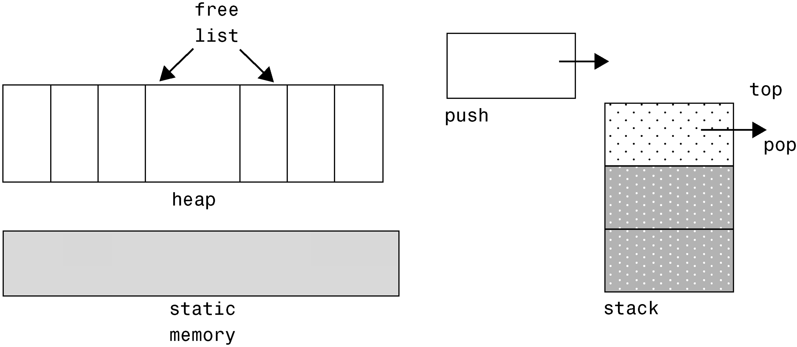
Pointers and Dynamic Memory Management (contd..)

Slide 156
Pointers and Dynamic Memory Management (contd..)
Dynamic memory allocation means that a block of memory requested by a program is removed from the heap, and can be used by this program.
Dynamic memory deallocation means that a program returns a block of memory to the heap - the de-allocated memory can be used the next time a memory request occurs.
The whole heap memory is (usually) returned to the operating system (OS) only after the termination of the program.

Slide 157
Pointers and Dynamic Memory Management (contd.)
In Java, garbage collector decides when inaccessible objects are deallocated.
Java objects are always allocated on the heap and never on the run-time stack, and all memory deallocation is done automatically by the garbage collector.
Memory leakage occurs when memory that is no longer needed by the program has not been freed and made available for reuse.
What's a reference to an object? It is (usually) a memory address; specifically, the address of a block of memory allocated for this object on the heap.

Slide 158
Pointers and Dynamic Memory Management (contd.)
In C++:
objects may be allocated both on the stack and in the heap
there is no standard garbage collector (utility libraries exist)
This may lead to various programming errors, mainly:
dangling reference problem - the result of a variable referencing a memory block whose lifetime has expired (allocated on the stack or heap and then deallocated, creating a so-called zombie object)
memory leakage.
The programmer is fully responsible for explicitly deallocating memory (using idioms and/or appropriate abstractions).

Slide 159
Pointers and Dynamic Memory Management (contd.)
Possible memory management errors are:
memory leakage
dangling references ("zombies")
duplicate deallocation (already deleted)
reallocation and use of memory still used by a zombie (a "ghost"?)
use and deallocation of not allocated memory (undefined pointer)
overflow of object or array boundaries (with pointers or whatever)
but "delete 0;" is allowed and OK.

Slide 160
Pointers and Dynamic Memory Management (contd.)
How to prevent C++ memory management errors:
the run-time system handles local stack-allocated objects, temporary objects in expressions, and parameters (provided other things go well..)
define explicit ownership for dynamic objects (who deletes?)
hide dynamic objects behind abstract data types (e.g., std::string)
use appropriate constructors, destructors, copy operations
use auto_ptr <>, reference counting, smart pointers (explained later)
after deallocation, remember to assign zero to the pointer

Slide 161
Placement new
There are many uses of placement new.
The simplest use is to place an object at a particular location in memory.
This is done by supplying the place as a pointer parameter to the new part of a new expression:
#include <new> // Must #include this to use "placement new"
class Employee {…};
void Fun()
{
char memory[sizeof(Employee)];
void* place = memory;
Employee* f = new(place) Employee();
// The pointers f and place will be equal
...
}
ADVICE: Don't use this "placement new" syntax unless you have to. Use it only when you really care that an object is placed at a particular location in memory.

Slide 162
Placement new (contd..)
DANGER:
You are taking sole responsibility that the pointer you pass to the "placement new" operator points to a region of memory that is big enough
and is properly aligned for the object type that you're creating.
You are also solely responsible for destructing the placed object.
This is done by explicitly calling the destructor:
void Fun()
{
char memory[sizeof(Employee)];
void* p = memory;
Employee* f = new(p) Employee();
...
f->~Employee(); // Explicitly call the destructor for the placed object
}
This is about the only time you ever explicitly call a destructor.

Slide 163
MODULE 7

Slide 164
Private Inheritance
Private inheritance gives is-implemented-in-terms-of relationship:
Inherit just the implementation of the various operations plus data structures. For example, you may need to operate on data with more stringent requirements, and so may need to restrict the original interface.
Further, these traits privately acquired by this derived class is totally sealed and cannot be inherited further down the inheritance hierarchy in a multi-level inheritance.

Slide 165
Protected Inheritance
All public features of the base class become protected features of the derived class (protected features of the base class continue to be protected in the derived class - the same for private features)
Useful if you do not want to finalize the derivations, that is you want to make it possible to have additional derived classes:
class PermanentEmp : protected Employee
{
public:
PermanentEmp ();
~PermanentEmp ();
//….
};

Slide 166
Inheritance & Access Specifiers
CA
PRIVATE
PROTECTED
PUBLIC
PRIVATE
PROTECTED
PUBLIC
CB
PRIVATE
PROTECTED
PUBLIC
class CB:private CA
{….};
CB
PRIVATE
PROTECTED
PUBLIC
class CB:protected CA
{….};
PRIVATE INHERITANCE
CB
PROTECTED INHERITANCE
class CB:public CA
{….};
PUBLIC INHERITANCE

Slide 167
Containment Vs. Inheritance
Private inheritance is a syntactic variant of composition (aggregation and/or has-a).
E.g., the “car has-a Engine" relationship can be expressed using simple composition:
class Engine
{
public:
Engine(int numCylinders);
void start(); // Starts this Engine
};
class Car
{
public:
Car() : e_(8) { } // Initializes this Car with 8 cylinders
void start() { e_.start(); }// Start this Car by starting its Engine
private:
Engine e_; // Car has-a Engine
};

Slide 168
Containment Vs. Inheritance
The "Car has-a Engine" relationship can also be expressed using private inheritance:
class Car : private Engine
{ // Car has-a Engine
public:
Car() : Engine(8) { } // Initializes this Car with 8 cylinders
using Engine::start; // Start this Car by starting its Engine
//Expose the hidden member –Publicizer Technique.
};
There are several similarities between these two variants:
  In both cases there is exactly one Engine member object contained in every Car object
  In neither case can users (outsiders) convert a Car* to an Engine*
  In both cases the Car class has a start() method that calls the start() method on the contained Engine object.

Slide 169
Containment Vs. Inheritance
There are also several distinctions:
  The simple-composition variant is needed if you want to contain several Engines per Car
  The private-inheritance variant can introduce unnecessary multiple inheritance
  The private-inheritance variant allows members of Car to convert a Car* to an Engine*
  The private-inheritance variant allows access to the protected members of the base class
  The private-inheritance variant allows Car to override Engine's virtual functions
  The private-inheritance variant makes it slightly simpler (20 characters compared to 28 characters) to give Car a start() method that simply calls through to the Engine's start() method

Slide 170
Hybrid Inheritance
class CA //BASE CLASS
{ private: int a;
public: //...
};
class CB:public CA
{
private: int b;
public: //...
};
class CC:public CA
{
private: int c;
public: //...
};
class CD:public CB, public CC
{
private: int d;
public: //...
};
CA
CA::a
CB
CC
CA::a
CB::b
CC:c
CB OBJECT LAYOUT
CD
CC OBJECT LAYOUT
CA::a
CB::b
CA::a
CC:c
CD::d
CD OBJECT LAYOUT

Slide 171
Virtual Inheritance
class CA //BASE CLASS
{ private: int a;
public: //...
};
class CB: virtual public CA
{
private: int b;
public: //...
};
class CC: virtual public CA
{
private: int c;
public: //...
};
class CD:public CB, public CC
{
private: int d;
public: //...
};
CA
ptr
ptr
CA::a
CB
CC
CA::a
CB::b
CC:c
CB OBJECT LAYOUT
CD
CC OBJECT LAYOUT
CA::a
ptr
CB::b
ptr
CC:c
CD::d
CA::a
CD OBJECT LAYOUT

Slide 172
C++ main programming rules to remember

Slide 173
What is OOP?
Object-Oriented Programming is a “philosophy” where the source code of a program is split into reusable objects.
What is an object, then?
An object is made of two parts:
The interface = catalog of the object features
The implementation = internal machinery

Slide 174
The interface in C++
Usually defined in a header (.h) file:
class Car
{
public:
// Members can be accessed from any object
protected:
// Can only be accessed by Car and its derived objects
private:
// Can only be accessed by Car for its own use.
};

Slide 175
Aggregation or Composition?
Car
4
Wheel
Person
Brain
Aggregation is a relationship in which one object is a part of another.
A aggregates B
=
B is part of A, but their lifetimes may be different
Ex: cars and wheels, engine, etc.
Composition is a relationship in which one object is an integral part of another
A composes B
=
B is part of A, and their lifetimes are the same
Ex: person and brain, lung, etc.

Slide 176
Classes: Basic Design Rules
Hide all member variables
Hide implementation functions and data
Minimize the number of public member functions
Avoid default constructors
Avoid overloading (can be ambiguous)
Use const members whenever possible / needed
Be aware of compiler generated functions
Notes:
default constructor can be overcome by default parameters.
Issue: default parameters and overloading can result in ambiguities: use overloading if the same action can be performed with different algorithms, use default values if a default value makes sense.
Complete and minimal classes...
default functions are written by the compiler if no one is declared for: default constructor (if no constructor at all is declared) under certain situations only ; destructor, under certain situations only; operator =
Constness: it is part of the design ! it is possible to bypass non-const implementations of const functions by using the keyword ‘mutable’ (or const_cast if mutable is not supported).

Slide 177
Inheritance: quick review
GeomShape
“A circle is a shape”
Circle
class GeomShape {
//…
};
class Circle : public GeomShape {
//…
};
file.h

Slide 178
Public Inheritance Philosophy
Public inheritance ⬄ ‘is a’
In other words:
What is applies to a base class applies to its derived classes
Three aspects to consider:
class public interface
class relationship with derived classes
class internal cookware
Notes:
example:
Student is a person: all the features of a person apply to a student; all that can be applied to a person can also be applied to a student

Slide 179
Polymorphism
Mechanism that allows a derived class to modify the behavior of a member declared in a base class
class Employee {
public :
virtual float income(); // 1000
};
class Boss : public Employee {
public :
virtual float income(); // 10000
};
Employee
Boss

Slide 180
Polymorphism (contd..)
A pure virtual function just defines the interface, and leaves the implementation to derived classes
Employee
class Employee {
public :
virtual float income() = 0;
// not implemented
};
class Boss : public Employee {
public :
virtual float income(); // implemented
};
Boss

Slide 181
Public Inheritance Philosophy
 | Inheritance of the interface | Inheritance of the implementation
Non virtual function | Mandatory | Mandatory
Virtual function | Mandatory | By default, Possible to redefine
Pure virtual function | Mandatory | Re-definition is mandatory

Slide 182
Private Inheritance Philosophy
Private inheritance ⬄ is implemented in term of
This is an equivalent variant of aggregation:
class Car : private engine
{
//…
};
class Car
{
private:
Engine engine_;
};

Slide 183
Inheritance and functions
Can have
Virtual Function
Pure Virtual function
Constructor is…
Destructor is…
Isolated class
No
No
Public
Public
Base class
Yes (must)
Yes / No
Public
Public Virtual
Pure Abstract class
Yes (must)
Yes / No
Protected
Public Virtual
Derived (concrete class)
Yes (must)
No
Public
Public Virtual

Slide 184
Consequences
Never call a virtual function in a constructor
Never declare a virtual function inline
Calling a virtual function is more expensive than calling a non-virtual function
Be aware of the increased size of classes with virtual functions

Slide 185
Additional guidelines...
Avoid multiple inheritance: use composition
Forbid default parameters in virtual functions
Don’t redefine (overload) a non virtual function
Differentiate between layering and inheritance
Notes:
Multiple inheritance:
ambiguity if two base class have the same function name
ambiguity because further design may result in several inheritance of the same base class.
Default parameters: statically bound, whereas virtual functions are dynamically bound.
Layering and inheritance:
class Set : public List {
};
not a good design: what applies to a List does not applies to a Set =>
class Set {
private :
List impl_;
};

Slide 186
Advanced Principles of Class design

Slide 187
What causes “Code Rot”?
It’s been blamed on stupidity, lack of discipline, and phases of the moon, but...
A case study
“The Copy Routine”

Slide 188
First Version
All designs start well
Copy
ReadKeyboard
WritePrinter
void copy(void)
{
int ch;
while( (ch=ReadKeyboard()) != EOF)
WritePrinter(ch);
}
The program is an overnight success!
How could it be more simple, elegant, and maintainable?

Slide 189
Second Version
Oh, no! Nobody said the requirements might change!
We sometimes want to read from paper tape reader.
We could put a parameter in the call, but we have hundreds of users already!
No big deal, this is just an exception… we can make it work.

Slide 190
Second Version Design
Copy
ReadKeyboard
WritePrinter
WritePrinter
ReadTape
bool GtapeReader = false; // remember to clear
void copy(void)
{
int ch;
while( (ch=GtapeReader ? ReadTape(): ReadKeyboard())
!= EOF)
WritePrinter(ch);
}

Slide 191
Third Version
How unexpected! Requirements changed again!
It seems that sometimes we need to write to a paper tape punch. We’ve had this problem before, and just added a flag. Looks like it should work again.
bool GtapeReader = false;
bool GtapePunch = false;
// remember to clear
void copy(void)
{
int ch;
while((ch=GtapeReader ? ReadTape():ReadKeyboard())!= EOF)
GtapePunch ? WritePunch(ch) : WritePrinter(ch);
}

Slide 192
Example of a Good Design
First and only version.
void Copy()
{
int c;
while( (c=getchar()) != EOF)
putchar(c);
}
But wait! Aren’t we supposed to be learning OO design? This isn’t OO is it?

Slide 193
…is it?
It is a small program based on abstractions!
FILE is an abstraction
  It represents some kind of byte stream
  It has many variations
It has methods
  Read, Write, getchar, putchar, etc
  The methods are *dynamically* bound
FILE is a class, just implemented differently.

Slide 194
Rephrased in OO
Copy
«interface»
«interface»
Reader
Writer
KeyboardReader
PrinterWriter
class Reader
{ virtual char read()=0; };
class Writer
{ virtual void write(char c)=0; };
void copy(Reader &itsReader, Writer &itsWriter)
{
int c;
while( (c==itsReader.read()) != EOF )
itsWriter.write(c);
}

Slide 195
Dependency Management Review
Why do programs tend to rot over time?
What is dependency management?
What are four qualities of good designs?
Are OO programs always simpler than non-OO versions?
Why would anyone want to use a paradigm that may result in more complex designs?
Why are compile and link time important?

Slide 196
Class Design Principles
SRP: The Single Responsibility Principle
OCP: The Open/Closed Principle
LSP: The Liskov Substitution Principle
ISP: The Interface Segregation Principle
DIP: The Dependency Inversion Principle

Slide 197
The Single Responsibility Principle
A class should have one, and only one, reason to change.
Payroll
Employee
+ CalcPay
+ ReportHours
+ WriteEmployee

Slide 198
The Single Responsibility Principle. (SRP)
Report
Writer
Employee
Payroll
+ CalcPay
Employee
Repository

Slide 199
Open/Closed Principle
“Modules should be open for extension, but closed for modification”
-Bertrand Meyer
A principle which states that we should add new functionality by adding new code, not by editing old code.
Defines a lot of the value of OO programming
Abstraction is the key

Slide 200
Abstraction is Key
Abstraction is the most important word in OOD
Client/Server relationships are “open”
Changes to servers cause changes to clients
Abstract servers “close” clients to changes in implementation.
Client
Server
Client
Abstract
Server
Concrete
Server

Slide 201
The Shape Example
Procedural (not closed) implementation
OO (closed) implementation

Slide 202
Procedural (open) version
Shape.h
DrawAllShapes.cpp
enum ShapeType {circle, square};
struct Shape
{enum ShapeType itsType;};
#include <Shape.h>
#include <Circle.h>
#include <Square.h>
typedef struct Shape* ShapePtr;
void
DrawAllShapes(ShapePtr list[], int n)
{
int i;
for( i=0; i< n, i++ )
{
ShapePtr s = list[i];
switch ( s->itsType )
{
case square:
DrawSquare((struct Square*)s);
break;
case circle:
DrawCircle((struct Circle*)s);
break;
}
}
}
Circle.h
struct Circle
{
enum ShapeType itsType;
double itsRadius;
Point itsCenter;
};
void DrawCircle(struct Circle*)
Square.h
struct Square
{
enum ShapeType itsType;
double itsSide;
Point itsTopLeft;
};
void DrawSquare(struct Square*)

Slide 203
What is wrong with the code?
It can be demonstrated to work. Isn’t that the important thing?
DrawAllShapes is not closed.
  Switch/case tend to recur in diverse places.
  If we add a shape, we add to the switch/case
  All switch/case statements must be found and edited.
  Switch/Case statements are seldom this tidy
  When we add to the enum, we must rebuild everything
The software is both rigid and brittle

Slide 204
A Closed Implementation
Circle.h
Shape.h
class Circle: public Shape
{
public:
virtual void Draw() const;
};
class Shape
{
public:
virtual void Draw() const =0;
};
DrawAllShapes.cpp
Square.h
#include <Shape.h>
void DrawAllShapes(Shape* list[],int n)
{
for(int i=0; i< n; i++)
list[i]->draw();
}
class Square: public Shape
{
public:
virtual void Draw() const;
};

Slide 205
Strategic Closure
No program is 100% closed.
Closure Against What?
  Closure is strategic. You have to choose which changes you’ll isolate yourself against.
  What if we have to draw all circles first? Now DrawAllShapes must be edited (or we have to hack something)
Opened Where?
  Somewhere, someone has to instantiate the individual shapes.
  It’s best if we can keep the dependencies confined

Slide 206
Open/Closed Review
What does the open/closed principle say?
What does that mean practically?
How can it be achieved?
What is strategic closure?
  How can this be achieved in design?
  What if you can’t close completely?

Slide 207
Liskov Substitution Principle
Derived classes must be usable through the base class interface, without the need for the user to know the difference.
All derived classes must be substitutable for their base classes
This principle guides us in the creation of abstractions.

Slide 208
Square/Rectangle
A square is-a rectangle, right? So lets consider Square as a subtype of Rectangle.
We can make it work:
Rectangle
-height : real
void Square::SetWidth(double w)
{
width = w;
height = w;
}
void Square::SetHeight(double h)
{
width = h;
height = h;
}
Uh, oh. This
doesn’t quite seem to fit
-width : real
+SetHeight()
+SetWidth()
Square

Slide 209
Substitution… denied!
It is reasonable for users of a rectangle to expect that height and width may change independently.
These expectations are preconditions and postconditions
  Bertrand Meyer calls it “Design by Contract”
  Post condition contract for rectangle is
    width = new Width
    height = old height.
Square violates Rectangle’s contract

Slide 210
Liskov Substitution Principle (cont.)
A client of rectangle expects height and width to be changed independently
  void setAspectRatio( Rectange* r, double ratio );
By deriving Square from Rectangle, we are allowing someone to set the aspect ratio of a Square !
We can still make it work
  if ( typeid(r) == typeid(Rectangle) )
  Violates Open/Closed Principle !

Slide 211
Liskov Substitution Principle (cont.)
Design by Contract
  Bertrand Meyer
  Preconditions, postconditions, invariants
Rectangle's postconditions for setWidth()
  width = newWidth
  length = oldLength
Square can require no more of clients, nor promise any less
  Doesn't maintain invariant of length
  Violates the contract

Slide 212
LSP Guides the Creation of Abstractions
Abstractions do not stand alone
Abstractions don’t always conform to real world expectations
Violating LSP is tantamount to violating the OCP

Slide 213
LSP Review
What does the LSP state?
What is the risk if LSP is violated?
What is Design by Contract?

Slide 214
Dependency Inversion Principle
Details should depend on abstractions. Abstractions should not depend on details.
Copy
Copy
Vs.
Reader
Writer
ReadKeyboard
WritePrinter
KeyboardReader
PrinterWriter

Slide 215
DIP Implications
Everything should depend upon abstractions
Avoid deriving from concrete classes
Avoid associating to concrete classes
Avoid aggregating concrete classes
Avoid dependencies on concrete components

Slide 216
Dependency Inversion Principle (cont.)
Legitimate reasons to violate
  Creation of objects
    new Circle creates a dependency on concrete class
    localize these dependencies using factories
  Nonvolatile classes
    string, vector, etc.
      - providing they are stable

Slide 217
Interface Segregation Principle
Helps deal with “fat” or inappropriate interfaces
Sometimes class methods have various groupings.
These classes are used for different purposes.
Not all users rely upon all methods.
This lack of cohesion can cause serious dependency problems
These problems can be refactored away.

Slide 218
Interface Pollution by “collection”
Distinct clients of our class have distinct interface needs.
Client 1
Client 2
Client 3
Server
+ C1Function()
+ C2Function()
+ C3Function()

Slide 219
A Segregated Example
Client 1
Client 2
Client 3
«interface»
«interface»
«interface»
Client 1
Client 2
Client 3
+ C1Function()
+ C2Function()
+ C3Function()
Server
+ C1Function()
+ C2Function()
+ C3Function()

Slide 220
ATM UI Example
Withdraw
Deposit
Transfer
«interface»
ATM UI
+ GetWithdrawAmountAndAccount()
+ GetDepositAmountAndAccount()
+ GetTransferAmountAndAccounts()
French ATM UI
English ATM UI

Slide 221
A Segregated ATM UI Example
Deposit
Withdraw
Transfer
«interface»
«interface»
«interface»
ATM Deposit UI
ATM Withdraw UI
ATM Transfer UI
+ GetDepositAmountAndAccount()
+ GetWithdrawAmountAndAccount
+ GetTransferAmountAndAccounts()
«interface»
ATM UI
+ GetWithdrawAmountAndAccount()
+ GetDepositAmountAndAccount()
+ GetTransferAmountAndAccounts()
French ATM UI
English ATM UI

Slide 222
Logger Example
Log Control
Application
Code needing to log something
«interface»
LogManager
«interface»
EventLog
+ SendLotToFile(name)
+ LogToMem(size)
+ Log(s: string*)
+ LogToConsole()
ManagedEventLog
+ Log(s: string*)
+ SendLotToFile(name)
+ LogToMem(size)
+ LogToConsole()

Slide 223
ISP Review
What is the ISP?
What does it affect?
How do these problems arise?
Does it really provide a real solution or just a restructuring of the problem?
When is it worth the effort?

Slide 224
Four Class Design Principles - Review
OCP Extend function without editing code
LSP Child instances substitute cleanly for base
DIP Depend on abstractions instead of details
ISP Split interfaces to manage dependencies

Slide 225
Virtual function Issues
It is strongly advised not to employ any statement that is going to call a virtual function in a base class constructor method.
As this statement would always end up in calling only the base class virtual function and not the appropriate derived class method in spite of the object belonging to a derived class.
#include<iostream> //Calling virtual function from constructor
using namespace std;
class CA
{
public:
CA() { this->fun(); }
virtual void fun(){ cout <<"CA fun"<<endl;}
};
class CB:public CA
{
public:
void fun(){ cout <<"over-ridden CB fun"<<endl;}
};
void main()
{
CB obj1;
}

Slide 226
Virtual function Issues
It is strongly advised not to employ any statement that is going to call a virtual function in a base class destructor method.
As this statement would always end up in calling only the base class virtual function and not the appropriate derived class method in spite of the object belonging to a derived class.
#include<iostream> //Calling virtual function from destructor
using namespace std;
class CA
{
public:
virtual void fun(){ cout <<"CA fun"<<endl;}
~CA(){cout <<"CA destructor"<<endl; this->fun(); }
};
class CB:public CA
{
public:
void fun(){ cout <<"over-ridden CB fun"<<endl;}
};
void main()
{
CB obj1;
}

Slide 227
Virtual function Issues
Unlike the base class constructor or destructor methods, it is appropriate to employ call to virtual member functions in a base class.
Such a call in an non-virtual member function of the base would always end up in calling the correct derived class method to which the object belongs.
#include<iostream> //Calling virtual function from non-virtual
using namespace std; //member function
class CA
{
public:
virtual void fun(){ cout <<"CA fun"<<endl;}
void nonvirtual(){ this->fun();}
};
class CB:public CA
{
public:
void fun(){ cout <<"over-ridden CB fun"<<endl;}
};

Slide 228
Virtual function Issues
void main() //Calling virtual function from non-virtual member
{ //function
CA *p = new(nothrow) CB;
p->nonvirtual();
delete p;
}

Slide 229
Virtual function issues
Whenever we plan to pass derived polymorphic class objects as function parameters pass the same by reference if they are stack objects.
If we pass by value it would lead to object slicing, that is upon the derived class object getting casted to a base kind we would end up loosing sub-object part, further the vptr field would end up pointing to the base class VTABLE and not the derived.
Consider the example in next slide..

Slide 230
Virtual function issues
This code leads to OBJECT SLICING
#include<iostream>
using namespace std;
class CA
{
public:
virtual void fun(){ cout <<"CA fun"<<endl;}
};
class CB:public CA
{
public:
void fun(){ cout <<"over-ridden CB fun"<<endl;}
};
//global function
void compute(CA x) //by value, leads to slicing
{
x.fun();
}
void main()
{
CB obj1;
compute(obj1);
}

Slide 231
Virtual function issues
This code AVOIDS OBJECT SLICING
#include<iostream>
using namespace std;
class CA
{
public:
virtual void fun(){ cout <<"CA fun"<<endl;}
};
class CB:public CA
{
public:
void fun(){ cout <<"over-ridden CB fun"<<endl;}
};
//global function
void compute(CA &x) //by reference, AVOIDS slicing
{
x.fun();
}
void main()
{
CB obj1;
compute(obj1);
}

Slide 232
VTABLE Layout

Slide 233
Virtual Tables & Late Binding
DATA SEGMENT
void circle::draw() { … }
circle::~circle() {…}
void rectangle::draw() { … }
rectangle::~rectangle() {…}
& circle::draw()
& circle::~circle()
& rectangle::draw()
& rectangle::~rect()
circle class VTABLE
rectangle class VTABLE
vptr radius
vptr radius length breadth
HEAP
Circle object
rectangle object
@@
##
##
##
@@
##
&&&
STACK
&&&
circle *p
circle *p

Slide 234
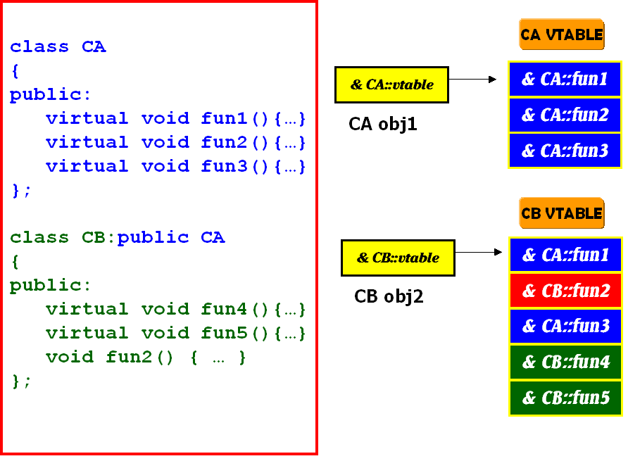
Multi-Level Inheritance & VTABLE Layout

Slide 235
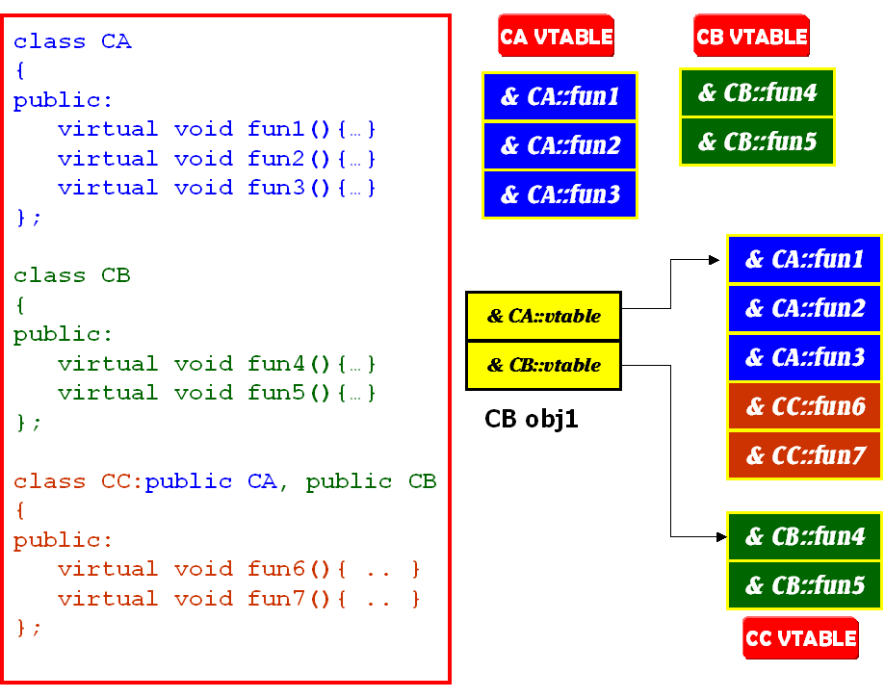
Multiple Inheritance & VTABLE Layout
CC obj1

Slide 236
RTTI

Slide 237
RTTI-Runtime Type Identification
RTTI
Because of polymorphism, when you write your program, you may not be able to know the exact type you are dealing with.
Run-time type information (RTTI) is used to find out the type of a polymorphic object.
Header file <typeinfo> defines operator typeid. It returns a const reference of class type_info, which is a class description of the operand.
Class type_info has a method name, which returns a char * which is the type name of the operand.

Slide 238
RTTI Table
VTABLE
OBJECT
LOCATOR
CLASS
HIERARCHY
& RTTI OBJECT
LOCATOR
-1
0
0
0
1
1
2
COUNT
(RTTI BASE CLASS ARRAY)
2
& TYPE DESCRIPTOR
& RTTI BASE
CLASS ARRAY
3
3
& CLASS HIERARCHY
DESCRIPTOR
4
& RTTI BASE CLASS
DESCPIPTOR.
BASE CLASS
ARRAY
CONST TYPEINFO &
& RTTI TYPE
DESCRIPTOR
0
0
1
1
BASE CLASS
DESCRIPTOR
2
2
3
RTTI TYPE
DESCRIPTOR
4
5
6

Slide 239
Example 1
// Getting the run time type information
#include <iostream>
#include <typeinfo>
using namespace std;
// polymorphic base class...
class __rtti Test
{
// This makes Test a polymorphic class type.
virtual void func() {};
};
// derived class...
class Derived : public Test {};
int main(void)
{
// Instantiate Derived type object...
Derived DerivedObj;
// Declare a Derived type pointer
Derived *DerivedPtr;
// Initialize the pointer
DerivedPtr = &DerivedObj;
//continued….

Slide 240
Example 1 (contd..)
// do the run time checking...
if(typeid(*DerivedPtr) == typeid(Derived))
// check the type of *DerivedPtr
cout<<"Ptr *DerivedPtr type name is <<typeid(*DerivedPtr).name();
if(typeid(*DerivedPtr) != typeid(Test))
cout<<"\nPointer DerivedPtr is not a Test class type.\n";
return 0;
}
OUTPUT:
c and f are different type.
int before double: 1
double before int: 0
class A before class B: 1

Slide 241
Example 2
#include <iostream>
#include <typeinfo>
using namespace std;
class Base
{
public:
virtual void funct(){}
};
class Derived:public Base{};
int main()
{
Derived* Test1 = new Derived;
Base* Test2 = Test1;
cout<<"The type name of Test1 is: ";
cout<<typeid(Test1).name()<<endl;
cout<<"The type name of *Test1 is: ";
cout<<typeid(*Test1).name()<<endl;
cout<<"The type name of Test2 is: ";
cout<<typeid(Test2).name()<<endl;
cout<<"The type name of *Test2 is: ";
cout<<typeid(*Test2).name()<<endl;
delete Test1;
return 0;
}

Slide 242
Example 2 (output)
OUTPUT:
The type name of Test1 is: class Derived *
The type name of *Test1 is: class Derived
The type name of Test2 is: class Base *
The type name of *Test2 is: class Derived

Slide 243
Gang of Four (GOF) Patterns at a glance
Overview
Design patterns are ways to reuse design solutions that other software developers have created for common and recurring problems.
Design patterns are not function or class "building block solutions".
In other words, a design pattern does not provide a reusable source code component.
The design pattern provides a framework that is customized for each particular problem need.
The benefits from these patterns include reductions in design and debugging time (sometimes quite dramatic).

Slide 244
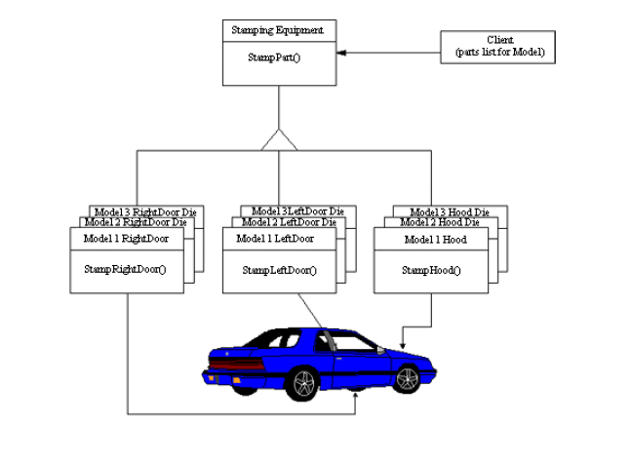
Abstract Factory
Intent
Provide an interface for creating families of related or dependent objects without specifying their concrete classes.

Slide 245
Abstract Factory (contd..)
Problem
If an application is to be portable, it needs to encapsulate platform dependencies. These "platforms" might include: windowing system, operating system, database, etc. Too often, this encapsulation is not engineered in advance, and lots of #ifdef case statements with options for all currently supported platforms begin to procreate like rabbits throughout the code.
AbstractProduct
AbstractFactory
+createProduct()::AbstractProduct
ConcreteProduct1
ConcreteProduct2
ConcreteFactory
<<creates>>
+createProduct()::AbstractProduct
+createProduct()::AbstractProduct
+createProduct()::AbstractProduct
<<creates>>

Slide 246
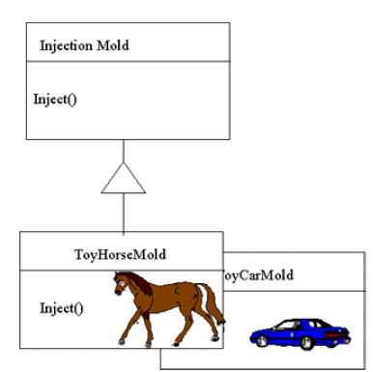
Factory Method
Intent
Define an interface for creating an object, but let subclasses decide which class to instantiate. Factory Method lets a class defer instantiation to subclasses.

Slide 247

Factory Method (contd..)
Problem :
A framework needs to standardize the architectural model for a range of applications, but allow for individual applications to define their own domain objects and provide for their instantiation.
Product
Creator
Product=factoryMethod();
+factoryMethod()::Product
+operation():void
Concrete Product
0..*
ConcreteCreator
return new ConcreteProduct();
<<creates>>
+factoryMethod()::ConcreteProduct

Slide 248
Singleton
Intent
Ensure a class has only one instance, and provide a global point of access to it.
Problem
Application needs one, and only one, instance of an object. Additionally, lazy initialization and global access are necessary.
Singleton
-instance:Singleton
return a copy of self
+Singleton()
+operation():void
+getinstance():instance

Slide 249
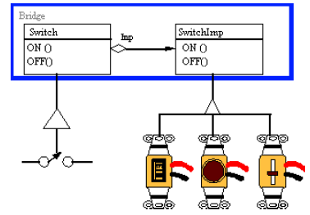
Bridge
Intent
Decouple an abstraction from its implementation so that the two can vary independently.

Slide 250
Bridge (contd..)
Problem
"Hardening of the software arteries" has occurred by using subclassing of an abstract base class to provide alternative implementations. This locks in compile-time binding between Interface and implementation. The abstraction and implementation cannot be independently extended or composed.
Abstraction
Implementor
imp
<<creates>>
imp.operatorImpl();
+operationImp():void
+operation():void
RefinedAbstraction
ConcreteImplementorA
ConcreteImplementorB
+operationImp():void
+operationImp():void

Slide 251
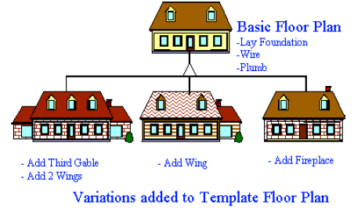
Template Method
Intent
Define the skeleton of an algorithm in an operation, deferring some steps to client subclasses. Template Method lets subclasses redefine certain steps of an algorithm without changing the algorithm's structure.

Slide 252
Template Method (contd..)
Problem
Two different components have significant similarities, but demonstrate no reuse of common interface or implementation. If a change common to both components becomes necessary, duplicate effort must be expended.
AbstractClass
primitiveOperation1();
primitiveOperation2();
+templateMethod():void
+primitiveOperation1():void
+primitiveOperation2():void
ConcreteClass
+primitiveOperation1():void
+primitiveOperation2():void

Slide 253
MODULE 8

Slide 254
Class Template
Class templates encourage software reusability by enabling type-specific versions of generic classes to be instantiated.
Class templates are called parameterized types, because they require one or more type parameters to specify how to customize a "generic class" template to form a class-template specialization.
The programmer who wishes to produce a variety of class-template specializations writes only one class-template definition.

Slide 255
Class Template
Each time an additional class-template specialization is needed, the programmer uses a concise, simple notation, and the compiler writes the source code for the specialization the programmer requires.
//A complete generic class supporting two unique types
template<typename T1, typename T2> class CA
{.....};
//complete specialization of the above generic class
template<>class CA<int, float>
{...}
//partial specialization, where one type is specific and the other //generic
template<typename T1, typename T2> class CA<int, T2>
{...}

Slide 256
Example
1
2 // Stack class template.
3 #ifndef STACK_H
4 #define STACK_H
5
6 template< typename T >
7 class Stack
8 {
9 public:
10 Stack( int = 10 ); // default constructor (Stack size 10)
11
12 // destructor
13 ~Stack()
14 {
15 delete [] stackPtr; // deallocate internal space for Stack
16 } // end ~Stack destructor
17
18 bool push( const T& ); // push an element onto the Stack
19 bool pop( T& ); // pop an element off the Stack
20
21 // determine whether Stack is empty
22 bool isEmpty() const
23 {
24 return top == -1;
25 } // end function isEmpty

Slide 257
Example(contd..)
26
27 // determine whether Stack is full
28 bool isFull() const
29 {
30 return top == size - 1;
31 } // end function isFull
32
33 private:
34 int size; // # of elements in the Stack
35 int top; // location of the top element (-1 means empty)
36 T *stackPtr; // pointer to internal representation of the Stack
37 }; // end class template Stack
38
39 // constructor template
40 template< typename T >
41 Stack< T >::Stack( int s )
42 : size( s > 0 ? s : 10 ), // validate size
43 top( -1 ), // Stack initially empty
44 stackPtr( new T[ size ] ) // allocate memory for elements
45 {
46 // empty body
47 } // end Stack constructor template
48
49 // push element onto Stack;
50 // if successful, return true; otherwise, return false

Slide 258
Example(contd..)
51 template< typename T >
52 bool Stack< T >::push( const T &pushValue )
53 {
54 if ( !isFull() )
55 {
56 stackPtr[ ++top ] = pushValue; // place item on Stack
57 return true; // push successful
58 } // end if
59
60 return false; // push unsuccessful
61 } // end function template push
62
63 // pop element off Stack;
64 // if successful, return true; otherwise, return false
65 template< typename T >
66 bool Stack< T >::pop( T &popValue )
67 {
68 if ( !isEmpty() )
69 {
70 popValue = stackPtr[ top-- ]; // remove item from Stack
71 return true; // pop successful
72 } // end if
73
74 return false; // pop unsuccessful
75 } // end function template pop
76 #endif

Slide 259
Code Blow
Whenever we are designing generic classes we got to look into an very important issue called code-blow.
What is code-blow?
Code-blow is nothing but redundant or unwanted code instantiated by the compiler without the knowledge of the generic class consumer.
When does it happen?
If a generic class consists of any member function(s) dealing only with type-specific data and generic, then such a situation is possible.
Consider the example in the following slide.

Slide 260
Code Blow (contd..)
#include<iostream>
using namespace std;
//An example on code blow
template<typename T> class Blow
{
private:
int a,b; //type specific members
T c,d; //generic members
public:
Blow(T x, T y, int i, int j):c(x),d(y),a(i), b(j)
{ }
void PrintAll()
{
cout <<"a = " << a <<", b="<< b << endl;
cout <<"c = " << c <<", d= "<< d << endl;
}
void PrintInt()
{
cout <<"a = " << a <<", b="<< b << endl;
}
};

Slide 261
Code Blow (contd..)
void main()
{
Blow<int> obj1(10,20, 300, 400);
obj1.PrintAll();
cout <<"--------------------"<<endl;
obj1.PrintInt();
cout <<"=============="<<endl;
Blow<float> obj2(12.34f, 54.47f, 500,600);
obj2.PrintAll();
cout <<"--------------------"<<endl;
obj2.PrintInt();
}
Given the code above, we would notice that the compiler would have instantiated or generated 2 PrintInt() functions –where both functions deal only with ‘int’ type data no matter the object is specialized for ‘int’ or ‘float’ type.

Slide 262
Code Blow Avoid
#include<iostream>
using namespace std;
//An example on avoiding code blow
class AvoidBlow
{
protected:
int a,b;
public:
AvoidBlow(int x, int y):a(x),b(y)
{ }
void PrintInt()
{
cout <<"a = " << a <<", b="<< b << endl;
}
};
template<typename T> class Blow:public AvoidBlow
{
private:
//int a,b;
T c,d;
public:
Blow(T x, T y, int i, int j):c(x),d(y), AvoidBlow(i,j) { }

Slide 263
Code Blow Avoid (contd..)
void PrintAll()
{
cout <<"a = " << a <<", b="<< b << endl;
cout <<"c = " << c <<", d= "<< d << endl;
}
/*
void PrintInt()
{ cout <<"a = " << a <<", b="<< b << endl; }
*/
};
void main()
{
Blow<int> obj1(10,20, 300, 400);
obj1.PrintAll();
cout <<"--------------------"<<endl;
obj1.PrintInt();
cout <<"=============="<<endl;
Blow<float> obj2(12.34f, 54.47f, 500,600);
obj2.PrintAll();
cout <<"--------------------"<<endl;
obj2.PrintInt();
}

Slide 264
Standard Template Library

Slide 265
Introduction
Industrial revolution - Reuse software, not re-write
Two main paradigms that permit code reuse - Object oriented design, Generic Programming
OOD facilitates code reuse by data hiding - Inheritance and Polymorphism
Generic programming facilitates code reuse by data independence - Templates and Overloading
STL is a combination of both OOD and Generic programming - collection of generic algorithms and containers that communicate through iterators.

Slide 266
Need for STL
Reusability - adaptability and efficiency
Highly adaptive components are usually implemented using complex inheritance, virtual function and RTTI - inefficient to be widely used
Highly efficient components - written in low level, platform dependent code - non-portable, hard to maintain
Solution:- Templates - containers and algorithms
Drawback - Programmer implemented (home made), not portable, less than 100% bug free and no common interface.
Thus, the lack of platform independent, bug free generic components gave rise to the creation of a library containing generic components with generic algorithms and common interface.

Slide 267
Structure of STL
The Standard Template Library contains the following five components
  Containers
  Iterators
  Algorithms
  Function objects
  Adaptors

Slide 268
Containers
Holds other object as its element
The allocation and de-allocation of these objects are controlled through constructors, destructors, insertion, and erase operation
There are two types -
  Sequence containers - vector, queue, deque, and list
  Associative containers - set, map, and multimap

Slide 269
Sequence Containers
Organizes a finite set of same type objects into a strictly linear arrangement
There are 3 basic types - vector, list and deque
The containers queue and stack are implemented using deque
The following are the header files used:
Header | Contents
vector | An array of T
list | A doubly linked list of T
deque | A double ended queue of T
queue | A queue of T
stack | A stack of T

Slide 270
Associative Containers
Facilitates fast retrieval of data based on keys
There are four types of associative containers - set, multiset, map, multimap
Parameterized on key and an ordering relation Compare
The keys in set and map are unique keys
The keys in multiset and multimap are equal keys
The following header files are used:
Header | Contents
map | An associative array of T
set | A set of T
bitset | A set of Boolean values

Slide 271
Sequence Containers - Example 1
#include<iostream>
#include<vector>
#include<string>
//using namespace std;
int main(){
//An object of vector containing string objects are created
vector <string> vs;
//Make room for 10 strings using the reserve(n) function.
//The reserve(n) function just allocates memory for n elements.
//Thus, this changes the value returned by the capacity() function.
vs.reserve(10);
//The member function push_back(T) appends a single element
//to the end of the container. If the container capacity
//is reached, it reallocates additional storage and appends
//the element.
vs.push_back(string()); //insert an element
//The size() function returns the number of elements that

Slide 272
Sequence Containers - Example 1(contd..)
//are currently stored in the container
cout << "Size: " << vs.size() << endl;
//The capacity() function returns the number of elements that
//the container can hold before reallocation
cout << "Capacity: " << vs.capacity() << endl;
//The difference in capacity() and size() gives the remaining
//space in the container.
cout << "There's room for " << vs.capacity() - vs.size()
<< " elements before reallocation" << endl;
//Allocate 10 more elements using resize(n); The resize(n) //function,in addition to allocating memory for n elements, //initializes them to default value. A different value can be //provided as the second argument if needed. Thus, this changes the //value returned by both capacity() and size()
vs.resize(20);
cout << "Size: " << vs.size() << endl;
cout << "Capacity: " << vs.capacity() << endl;
return 0;
}

Slide 273
Sequence Containers - Example 1 (output)
Size: 1
Capacity: 10
There's room for 9 elements before reallocation
Size: 20
Capacity: 20

Slide 274
Sequence Containers - Example 2
This example illustrates the use of Front and Back operations.
#include<iostream>
#include<vector>
#include<string>
using namespace std;
int main(){
vector <string> vs;
vs.push_back("string 1"); //insert an element
vs.push_back("string 2"); //insert an element
cout << "Size: " << vs.size() << endl;
cout << "Capacity: " << vs.capacity() << endl;
//The member function front() accesses a single
//element at the front of the container
//

Slide 275
Sequence Containers - Example 2(contd..)
cout << "Front: " << vs.front() << endl;
//The member function back() accesses a single
//element at the back of the container
//
cout << "Back: " << vs.back() << endl;
//The member function pop_back() removes the
//last element from the container. This funciton
//does not return the removed object.
vs.pop_back(); //Remove vs[1]
cout << "Front: " << vs.front() << endl;
cout << "Back: " << vs.back() << endl;
cout << "Size: " << vs.size() << endl;
cout << "Capacity: " << vs.capacity() << endl;
return 0;
}

Slide 276
Sequence Containers - Example 2 (output)
Size: 2
Capacity: 2
Front: string 1
Back: string 2
Front: string 1
Back: string 1
Size: 1
Capacity: 2

Slide 277
Sequence Containers - Example 3
This example illustrates the use of Container assignment.
#include<iostream>
#include<vector>
using namespace std;
int main(){
//Create a vector of Short integers.
vector <short> vs;
vs.push_back(1); //insert an element
vs.push_back(2); //insert an element
vs.push_back(3); //insert an element
vs.push_back(4); //insert an element
//Get the size and capacity of the container
cout << "Size: " << vs.size() << endl;
cout << "Capacity: " << vs.capacity() << endl;
//Get the front and back elements of the container
cout << "Front: " << vs.front() << endl;
cout << "Back: " << vs.back() << endl;
Remove the last element
vs.pop_back(); //Remove vs[3]

Slide 278
Sequence Containers - Example 3(contd..)
cout << "Front: " << vs.front() << endl;
cout << "Back: " << vs.back() << endl;
cout << "Size: " << vs.size() << endl;
cout << "Capacity: " << vs.capacity() << endl;
//Create a new vector object
vector <short> new_vector;
//Assign the existing object to the new one
new_vector = vs;
//Print the size and capacity of the new vector
cout << "Size: " << new_vector.size() << endl;
cout << "Capacity: " << new_vector.capacity() << endl;
//Access the elements of the new vector using the index [] operator
cout << "New vector[0]: " << new_vector[0] << endl;
cout << "New vector[1]: " << new_vector[1] << endl;
cout << "Front: " << new_vector.front() << endl;
cout << "Back: " << new_vector.back() << endl;
return 0;
}

Slide 279
Sequence Containers - Example 3 (output)
Size: 4
Capacity: 4
Front: 1
Back: 4
Front: 1
Back: 3
Size: 3
Capacity: 4
Size: 3
Capacity: 3
New vector[0]: 1
New vector[1]: 2
Front: 1
Back: 3

Slide 280
Sequence Containers - Example 4
This example illustrates the use of push(), pop(), Front and Back operations on a queue object.
#include<iostream>
#include<queue>
using namespace std;
int main(){
queue <int> iq; // Create an integer queue object
iq.push(29);
iq.push(239);
iq.push(344);
iq.push(541);
cout << "Size of the queue is: " << iq.size() << endl;
while (!iq.empty()){
cout << "The top most element is: " << iq.front() << endl;
cout << "The bottom most element is: " << iq.back() << endl <<
endl;
iq.pop();
}
return 0;
}

Slide 281
Sequence Containers - Example 4 (output)
Size of the queue is: 4
The top most element is: 29
The bottom most element is: 541
The top most element is: 239
The bottom most element is: 541
The top most element is: 344
The bottom most element is: 541
The top most element is: 541
The bottom most element is: 541

Slide 282
Algorithms
STL contains a rich collection of algorithms that can be applied to a variety of containers.
There are approximately 70 standard algorithms
Operate on elements of containers indirectly through iterators
There are three main types of algorithms.
  Non-mutating sequence operations
  Mutating sequence operations
  Sorting Algorithms

Slide 283
Non-mutating sequence operations
These algorithms do not modify the sequence on which they operate.
They include searching, checking for equality, and counting, for example
Example -
  find( ) - Locates an element within a sequence. Takes 3 arguments, the first 2 are iterators that point to begin and end of sequence respectively. The third element is the value to be found. Returns an iterator that points to the first element that is identical to the value to be found.

Slide 284
Non-mutating sequence operations(contd..)
Modifies the sequence on which they operate
Includes operations such as copy, fill, replace, and transform, for example
Example -
  copy( ) - This is a generic function that can be used to copy a sequence of objects to specific target. Takes 3 arguments. The first 2 are the begin and end iterators of the object to be copied and the third is the target object.

Slide 285
Sorting operations
Algorithms for sorting and merging sequences
Algorithms for set operations for sorted sequences
Includes sort(), partial_sort(), binary_search(), for example
Example
  sort( ) - takes two arguments of type const iterator that point to the beginning and the end of the sequence respectively.

Slide 286
MODULE 9

Slide 287
Exception Handling

Slide 288
Purpose of Exception Handling
Deal with errors in an elegant manner
Write clearer, most robust, and fault tolerant program
Error handling code
  Minimum --- Casual Systems
  Extensive --- Commercial products

Slide 289
Dealing with Errors
Errors are interspersed throughout the software. Errors are handled where they occur.
  Programmer can see the error processing near to the code and determine the appropriateness of the error processing code.
  Code becomes "polluted" with error processing. More difficult for a programmer concerned with the application itself to read the code and determine if the code is functioning completely.
User exception handling techniques
  Remove error code from the "main code"
  better readability and modifiability
Exception Handling – remove the error handling code from the “main-line” of the program’s execution – improves program readability and maintainability – catch all kinds of exceptions, or a subset of them – programs become more robust

Slide 290
Dealing with Errors(contd..)
Memory allocation, Arithmetic Exceptions, Invalid Parameters, Array Bounds, etc. – synchronous errors.
Used in situations where the system can recover from the error causing the exception – the recovery procedures is called the exception handler.
Exception handling is typically used when the error will be dealt with by a different part of the program (i.e. a different scope) from where the error was detected.
Particularly useful for graceful degradation.
Use only to process exceptional situations.

Slide 291
Dealing with Errors(contd..)
To process exceptions for program components that are not geared to handle those exceptions directly.
To process exception from software components, such as functions, libraries, classes, etc., that are likely to be widely used and where it does not make sense for those components to handle their own exceptions.
To handle error processing in a uniform manner across large-scale projects.
Use assert macro - if an assertion is false, program terminates - useful at debugging

Slide 292
Dealing with Errors(contd..)
Ignore exceptions!
Abort program - what if resources were allocated to a program and it aborted? ("Resource Leak")
Set and test error indicators - need to check them at all points in the program

Slide 293
Error Handling - Method to Cope with Uncertainties
A Function which Finds that it Cannot Cope With a Problem Throws an Exception, Hoping that Caller can Handle that Problem
A Function that Wants to Handle that Kind of a Problem can Indicate that it is Willing to Catch that Exception
Method of Transferring Control and Information to an Associated Exception Handler
A try Block Constitutes the Section of the Program that is Subject to Exception Checking
A Handler is Invoked with a throw Expression from within the try Block
The Handler is the catch Function

Slide 294
Error Handling - Method to Cope with Uncertainties (cont)
Flow of Control
Handler class
try Block
throw Expression
Control
constructor
Control
Catch function
Control
FUNCTION

Slide 295
Invoking of Handler
The Type of the Object Argument of the throw Expression Determines the Appropriate catch Invocation
A throw Expression Without an Argument Re-throws the Exception Being Handled Again. Such a throw Expression MAY APPEAR ONLY IN A HANDLER or in a Function Directly Called From the Handler
The catch (...) Handler, if Present, CAN Handle ALL Exception Classes

Slide 296
Invoking of Handler
If NO Appropriate Handler is Present, the unexpected() Function is Invoked. It Passes the Control to terminate() Function and can Cause Termination
The throw Expression is First Passed to the Appropriate Constructor for the Class -- A Default Constructor MAY be Created, if Needed -- No Constructor is Used for Non-Classes. The Processing is then Passed to the Handler

Slide 297
catch Handlers
The catch Handler MUST IMMEDIATELY FOLLOW the Appropriate try Block or Other catch Handlers
The Placement Order is Significant. Control is Passed to the FIRST HANDLER THAT CAN HANDLE THE CONDITION
The catch(...) Handler, if Present, SHOULD BE THE LAST HANDLER

Slide 298
Simple Exception Handler – Example 1
    #include <iostream>
    using namespace std;
    main()
    {
    //try Block
    try
    {
    throw(long(1));
    }
    //Handlers
    catch (int x)
    {
    cout << "Catch Integer " << x << endl;
    }
    catch (long x)
    {
    cout << "Catch Long " << x << endl;
    }
    catch (...)
    {
    cout << "Catch Rest" << endl;
    }
    }
    OUTPUT WILL BE:
    ------ ---- --
    Catch Long 1

Slide 299
An Exception Handler Class – Example 2
#include<stream>
#include<cstdlib> //exit()
using namespace std;
class zero
{
public:
zero() //Constructor
{
cout<<"Class Zero Constructor Invoked!!"<<endl;
}
};
//Exception Checker Function
void zero_check(int i)
{
if (i == 0)
throw zero(); //Argument is of zero class type.
}

Slide 300
An Exception Handler Class – Example 2 (contd..)
main()
{
//try block
try
{
for (int i = 2; ; i--)
{
zero_check(i);
cout << "Reciprocal: " << 1.0/i << endl;
}
}
//Handler
catch(zero)
{cout << "DIVIDE BY ZERO -- ERROR!!\n"; exit(-1);}
}
OUTPUT WILL BE:
------ ---- ---
Reciprocal: 0.5
Reciprocal: 1
Class Zero Constructor Invoked!!
DIVIDE BY ZERO -- ERROR!!

Slide 301
An Exception Handler Class – Example -3
// A simple exception handling example.
// Checking for a divide-by-zero exception.
#include <iostream>
using std::cout;
using std::cin;
using std::endl;
// Class DivideByZeroException to be used in exception
// handling for throwing an exception on a division by zero.
class DivideByZeroException {
public:
DivideByZeroException()
: message( "attempted to divide by zero" ) { }
const char *what() const { return message; }
private:
const char *message;
};
// Definition of function quotient. Demonstrates throwing
// an exception when a divide-by-zero exception is encountered.
double quotient( int numerator, int denominator )
{
if ( denominator == 0 )
throw DivideByZeroException();
return static_cast< double > ( numerator ) / denominator;
}

Slide 302
An Exception Handler Class – Example –3 (contd..)
// Driver program
int main()
{
int number1, number2;
double result;
cout << "Enter two integers (end-of-file to end): ";
while ( cin >> number1 >> number2 ) {
// the try block wraps the code that may throw an
// exception and the code that should not execute
// if an exception occurs
try {
result = quotient( number1, number2 );
cout << "The quotient is: " << result << endl;
}
catch ( DivideByZeroException ex ) { // exception handler
cout << "Exception occurred: " << ex.what() << '\n';
}
cout << "\nEnter two integers (end-of-file to end): ";
}
cout << endl;
return 0; // terminate normally
}

Slide 303
An Exception Handler Class – Example (3) Output
OUTPUT:
Enter two integers (end-of-file to end): 100 7
The quotient is: 14.2857
Enter two integers (end-of-file to end): 100 0
Exception occurred: attempted to divide by zero
Enter two integers (end-of-file to end): 33 9
The quotient is: 3.66667
Enter two integers (end-of-file to end):

Slide 304
Throwing an Exception
throw - indicates an exception has occurred
  Usually has one operand (sometimes zero) of any type
    If operand an object, called an exception object
    Conditional expression can be thrown
  Code referenced in a try block can throw an exception
  Exception caught by closest exception handler
  Control exits current try block and goes to catch handler (if it exists)
  Example (inside function definition)
  if ( denominator == 0 )
  throw DivideByZeroException();
    Throws a dividebyzeroexception object
Exception not required to terminate program
  However, terminates block where exception occurred

Slide 305
Catching an Exception
Exception handlers are in catch blocks
  Format: catch( exceptionType parameterName)
  {
    exception handling code
    }
  Caught if argument type matches throw type
  If not caught then terminate called which (by default) calls abort
  Example:
  catch ( DivideByZeroException ex)
  {
  cout << "Exception occurred: " << ex.what() <<'\n'
  }
Catches exceptions of type DivideByZeroException

Slide 306
Catching an Exception (contd..)
Catch all exceptions
  catch(...) - catches all exceptions
    You do not know what type of exception occurred
    There is no parameter name - cannot reference the object
If no handler matches thrown object
  Searches next enclosing try block
    If none found, terminate called
  If found, control resumes after last catch block
  If several handlers match thrown object, first one found is executed

Slide 307
Catching an Exception (contd..)
catch parameter matches thrown object when
  They are of the same type
    Exact match required - no promotions/conversions allowed
  The catch parameter is a public base class of the thrown object
  The catch parameter is a base-class pointer/ reference type and the thrown object is a derived-class pointer/ reference type
  The catch handler is catch( ... )
  Thrown const objects have const in the parameter type

Slide 308
Catching an Exception (contd..)
Unreleased resources
  Resources may have been allocated when exception thrown
  catch handler should delete space allocated by new and close any opened files
catch handlers can throw exceptions
  Exceptions can only be processed by outer try blocks

Slide 309
Rethrowing an Exception
Rethrowing exceptions
  Used when an exception handler cannot process an exception
  Rethrow exception with the statement: throw;
    No arguments
    If no exception thrown in first place, calls terminate
  Handler can always rethrow exception, even if it performed some processing
  Rethrown exception detected by next enclosing try block

Slide 310
Rethrowing an Exception -Example
// Demonstration of rethrowing an exception.
#include <iostream>
using std::cout;
using std::endl;
#include <exception>
using std::exception;
void throwException()
{
// Throw an exception and immediately catch it.
try {
cout << "Function throwException\n";
throw exception(); // generate exception
}
catch( exception e )
{
cout << "Exception handled in function throwException\n";

Slide 311
Rethrowing an Exception –Example (contd..)
throw; // rethrow exception for further processing
}
cout << "This also should not print\n";
}
int main()
{
try {
throwException();
cout << "This should not print\n";
}
catch ( exception e )
{
cout << "Exception handled in main\n";
}
cout << "Program control continues after catch in main" << endl;
return 0;
}
OUTPUT:
Function throwException
Exception handled in function throwException
Exception handled in main
Program control continues after catch in main

Slide 312
Exception specifications
Exception specification (throw list)
  Lists exceptions that can be thrown by a function
Example:
  int g( double h ) throw ( a, b, c )
  {
  // function body
  }
  Function can throw listed exceptions or derived types
  If other type thrown, function unexpected called
  throw() (i.e., no throw list) states that function will not throw any exceptions
    In reality, function can still throw exceptions, but calls unexpected (more later)
  If no throw list specified, function can throw any exception

Slide 313
Processing Unexpected Exceptions
Function unexpected
  Calls the function specified with set_unexpected
    Default: terminate
Function terminate
  Calls function specified with set_terminate
    Default: abort
set_terminate and set_unexpected
  Prototypes in <exception>
  Take pointers to functions (i.E., Function name)
    Function must return void and take no arguments
  Returns pointer to last function called by terminate or unexpected

Slide 314
Usages
Arithmetic Exceptions -- Divide by Zero
Range Exceptions -- Overflow, Underflow
Memory Exceptions -- Dynamic Memory Allocations

Slide 315
Example-4
// domain_error and typeid()
#include <iostream>
using namespace std;
int main()
{
try
{
throw domain_error("Some error with your domain!");
}
catch (exception &err)
{
cerr<<"Caught: "<<err.what()<<endl;
cerr<<"Type: "<<typeid(err).name()<<endl;
};
}
Output:
Caught: Some error with your domain!
Type: class std::domain_error

Slide 316
Example-5
// bad_typeid
#include <typeinfo>
#include <iostream>
using namespace std;
class Test
{
public:
// object for a class needs vtable for the rtti
Test();
virtual ~Test();
};
int main()
{
Test *ptrvar = NULL;
try {
// the error condition
cout<<typeid(*ptrvar).name()<<endl;
}
catch (bad_typeid)
{
cout<<"The object is NULL"<<endl;
}
}
Output:
The object is NULL

Slide 317
Example-6
// set_unexpected()
#include <exception>
#include <iostream>
using namespace std;
void myfunction()
{
cout<<"Testing myfunction()."<<endl;
// terminate() handler
terminate();
}
int main( )
{
unexpected_handler oldHandler = set_unexpected(myfunction);
// unexpected() function call
unexpected();
}
Output:
The Debug Error message box should be expected.

Slide 318
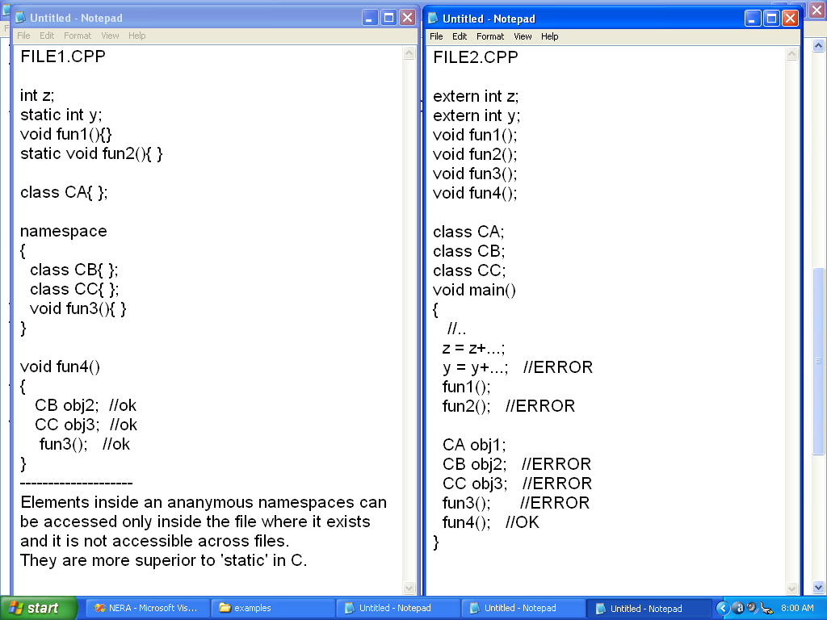
Anonymous namespace

Slide 319
References
C++ Primer by Lippman.
Inside Objects by Lippman
C++ By Bjarne Stroustrup
C++ Bible by AL Stevens
Complete Reference by Herbert Schildt.
Advanced C++ James coplin
Effective C++ Scott meyers
More Effective C++ Scott meyers
Effective STL Scott meyers
Design Patterns (GOF)

